Slide 1
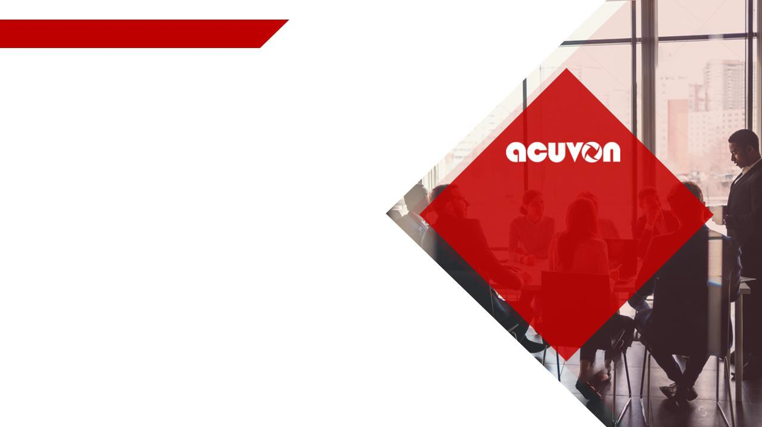

AMERICANA LAST MILE DELIVERY PLATFORM (System Design & Architecture)
RESTAURANT DIVISION
GREAT PEOPLE, GREAT
FOOD, GREAT COMPANY

Slide 2
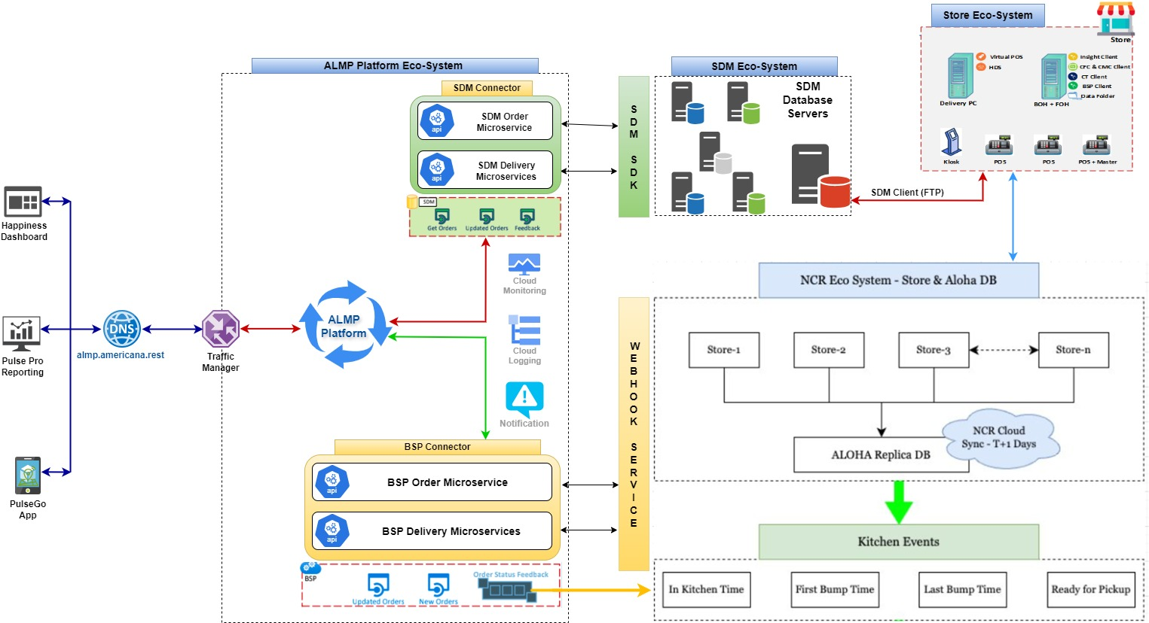
ALMP Proposed BSP and SDM Integration – Design Architecture 1.0.0

Slide 3
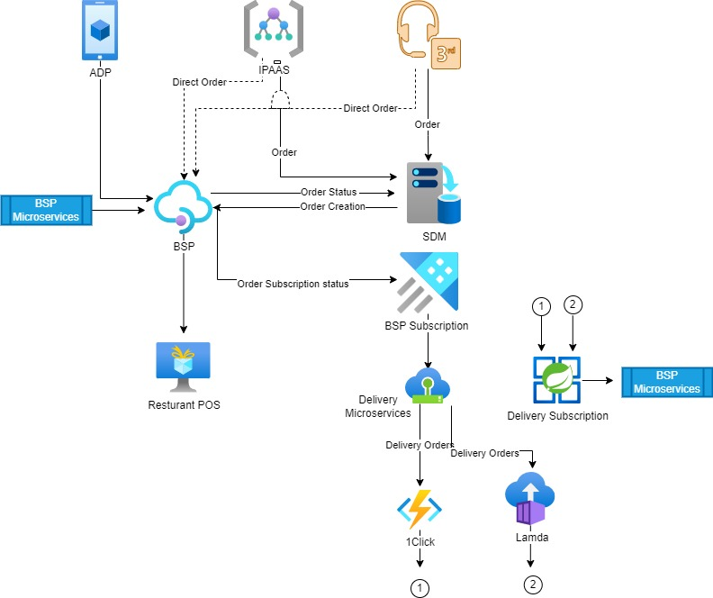
ARC –What’s Next
BSP Subscription : All BSP Orders synchronized with Americana BSP subscription system.
USE MuleSoft IPAAS
USE Azure or Cloud Integration Services
Use Open-Source Integration services on top of ADP.
Delivery Microservices:
Delivery Subscription : All delivery Orders synchronized with Americana Delivery subscription system.
BSP Order Closure Microservices:
Removal of SDM/SDK Dependency
Lengthy outages​
Losing orders​
Direct profit loss ​
Customer dissatisfaction​
Brand and company Reputation

Slide 4
Americana Final Solution
Master data

Slide 5
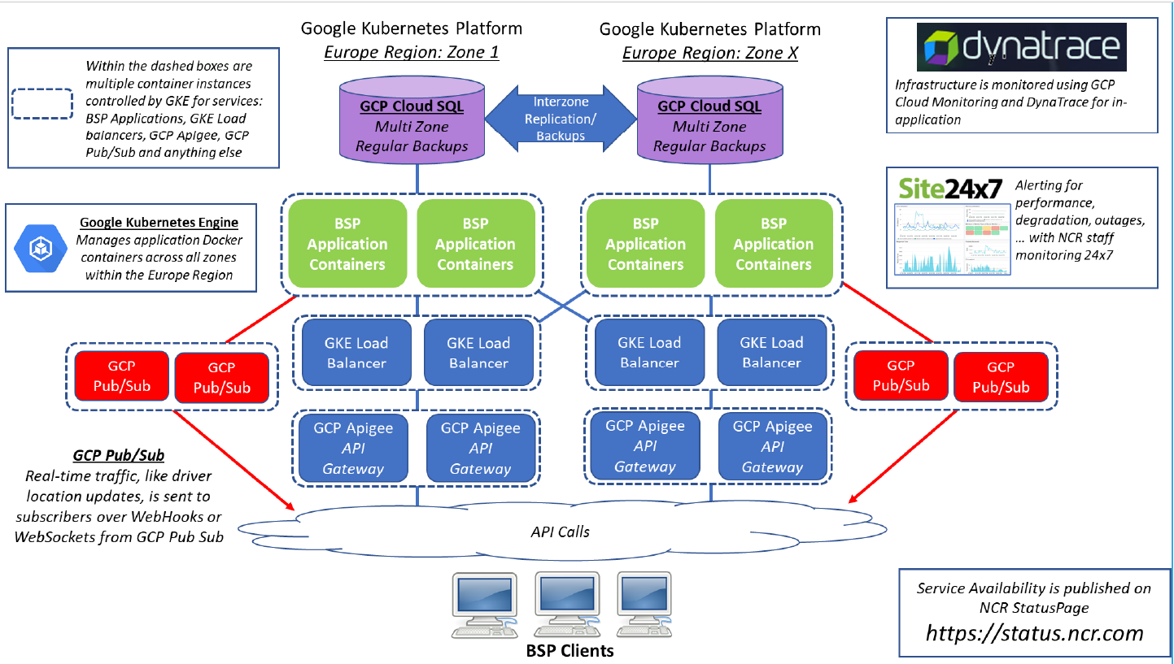
ARC – BSP Architecture
The NCR BSP infrastructure is built on the Google Cloud Platform which incorporates Google’s best high availability and distributed computing technology. All services and applications within the BSP are built upon container technology and managed by Google Kubernetes Engine. Below is a diagram of how it is architected.

Slide 6
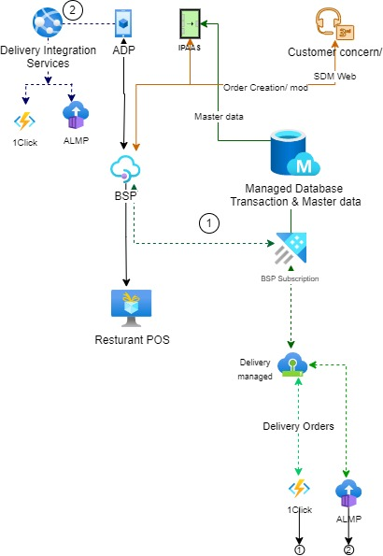
ARC –Transition State Phase -2
ADP –BSP -Store connection
BSP -SDM web call center management
Delivery management – without SDM
Last mile order integration with centralized subscription system.
Centralized Database for transaction and master data
ADP direct integrate with 1click
4. Delivery order closure and BSP status sync

Slide 7
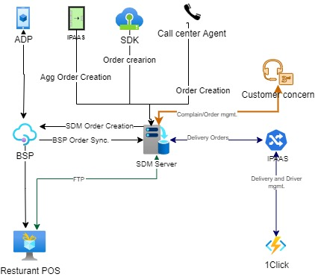
ARC –Transition State Phase -1
Phase 1 Actionable
Enable BSP platform for ADP
BSP–SDM Sync, Keeping call center Business as usual
IPASS-SDM Last mile order integration
Delivery order status to BSP
Dedicated server for optimal order sync process.
Incase of BSP connectivity failure alternate path will exists
High Level Date
Solution Available date : 15th Jun
QA Commence Date : 16th Jun
UAE Store Pilot Date : 18th July
KSA Store Pilot Date : 1st August
Digital Direct integration in across all stores UAE –KSA : 30th Sep
Risk | Mitigation
BSP order service | Redundant infra 24x7 monitoring BSP support team
BSP -SDM Sync failure | Dedicated primary server and subscription enablement
SDM –BSP Sync failure | Manual HDS operation
Master Data
Store master
Area master
Menu master
Payment tender
Promos
Customer
Address

Slide 8
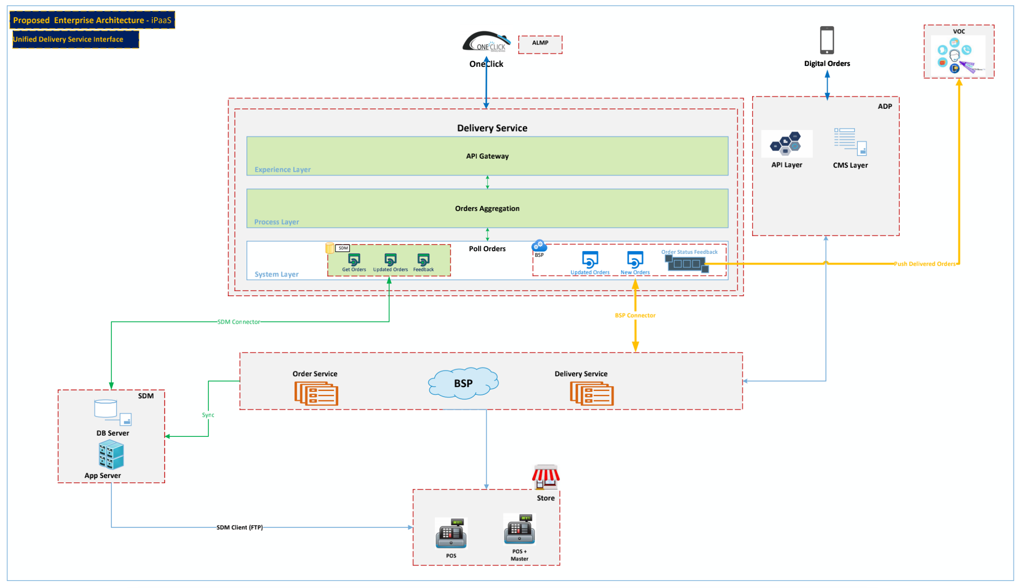
IPAAS BSP DELIVERY SERVICE Removing dependency for Lamda inetgartion

Slide 9
Solution Architecture
SOLUTION ARCHITECTURE – UNIFIED CLIENT (BSP & SDM)
Component Summary
BOH
File Server
Crunch Time Client
ATO
CFC & CMC Client
Aloha Insight Client
HDS PC
SDM Client
ATO Interface for managing BSP orders
Removal of Component
Route Summary
IPAAS – ADP Service Connection for master data
ADP – SDM SDK connection for master data & failover order injection
SDM – Unified POS Client connection
ADP – BSP connection
ATO – BSP connection
SDM – BSP connectivity for order sync & call center order injection
IPAAS can connect with BSP – for order injection and order subscription for Delivery integration
Kiosk Connection with BSP – Alternative
BSP- Store Connectivity
1
A
B
2
G
D
3
4
H
F
A
B
E
C
I
C
2
1
D
E
F
G
H
I

Slide 10

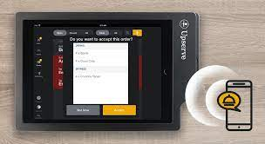

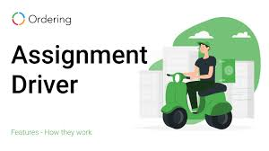
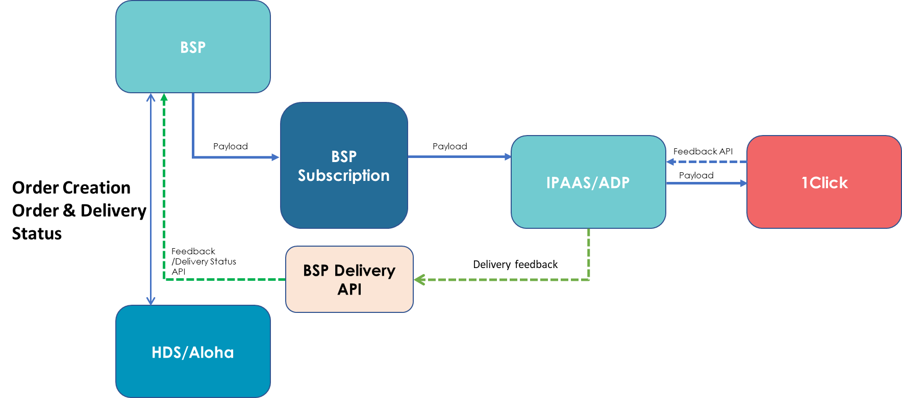
ARC – CCOD - DRIVER ASSIGNMENT & LAST MILE PAYMENT HANDLING
PS: Store Pilot-Run Planned : 2nd Week of August
Improving store efficiencies in cost and service
Close the order in HDS once order is delivered
Automated Payment method update at POS level by handling payment method change at customer end.
Automatically assign the driver on HDS.
SDM/
ADP

Slide 11
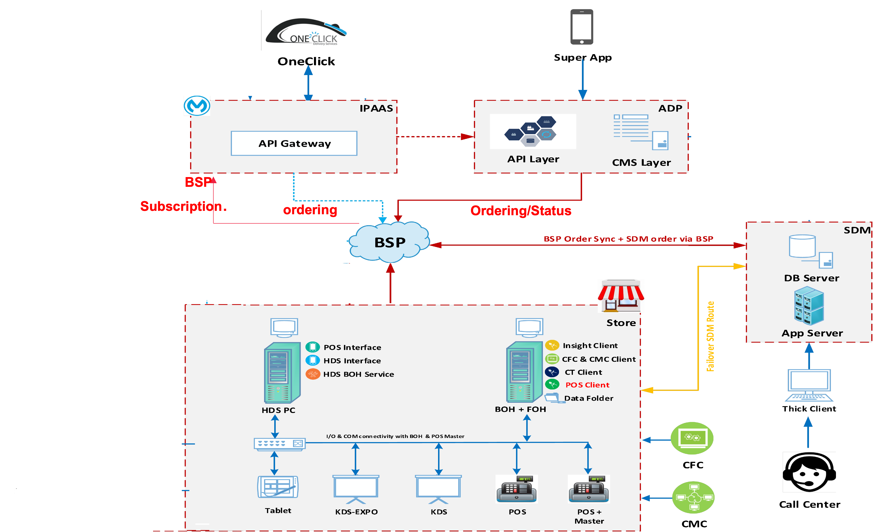
DIGITAL: DIRECT BSP INTEGRATION
3
D
Route-1: Direct Order Injection with BSP
ADP - BSP – Store – BSP – IPAAS - 1Click
3
5
S
D
1
5
Back Syncing to SDM
ADP – BSP – STORE – SDM
3
5
S
1
S

Slide 12
FIRST 20 STORE – AMERICANA ECO SYSTEM BSP INTEGRATION
Mobile App
BSP
Store
Call Center
SDM
BSP
Store
Aggregators
SDM
BSP
Store
IPASS
4 STORE – ONLY DIGITAL BSP DIRECT INTEGRATION
Mobile App
BSP
Store
Call Center
SDM
Store
Aggregators
SDM
Store
IPASS

Slide 13

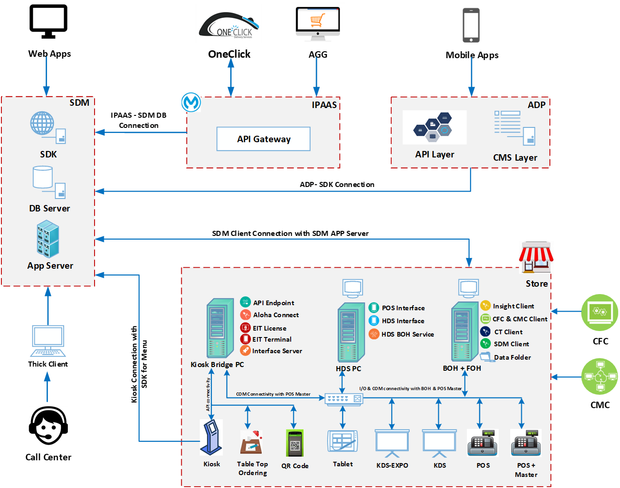
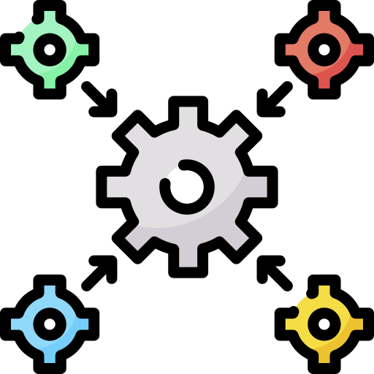



Americana Restaurants Connect (ARC)
Current Architecture
Key CHALLENGES
Challenges with SDM systems
Single point of failure
Downtimes at peak business days/hours
Challenges with POS systems
Dine-in, carhop & DriveThru order modes are not supported.
Additional h/w required for kiosk
No automated order closure at POS
Absence of real-time delivery updates to customers
Payment tenders are not captured properly for home delivery orders.
In-stores operational challenges
Orders are visible in back-office systems causing customer concerns.
Calculation of the speed of service for delivery orders.

Slide 14
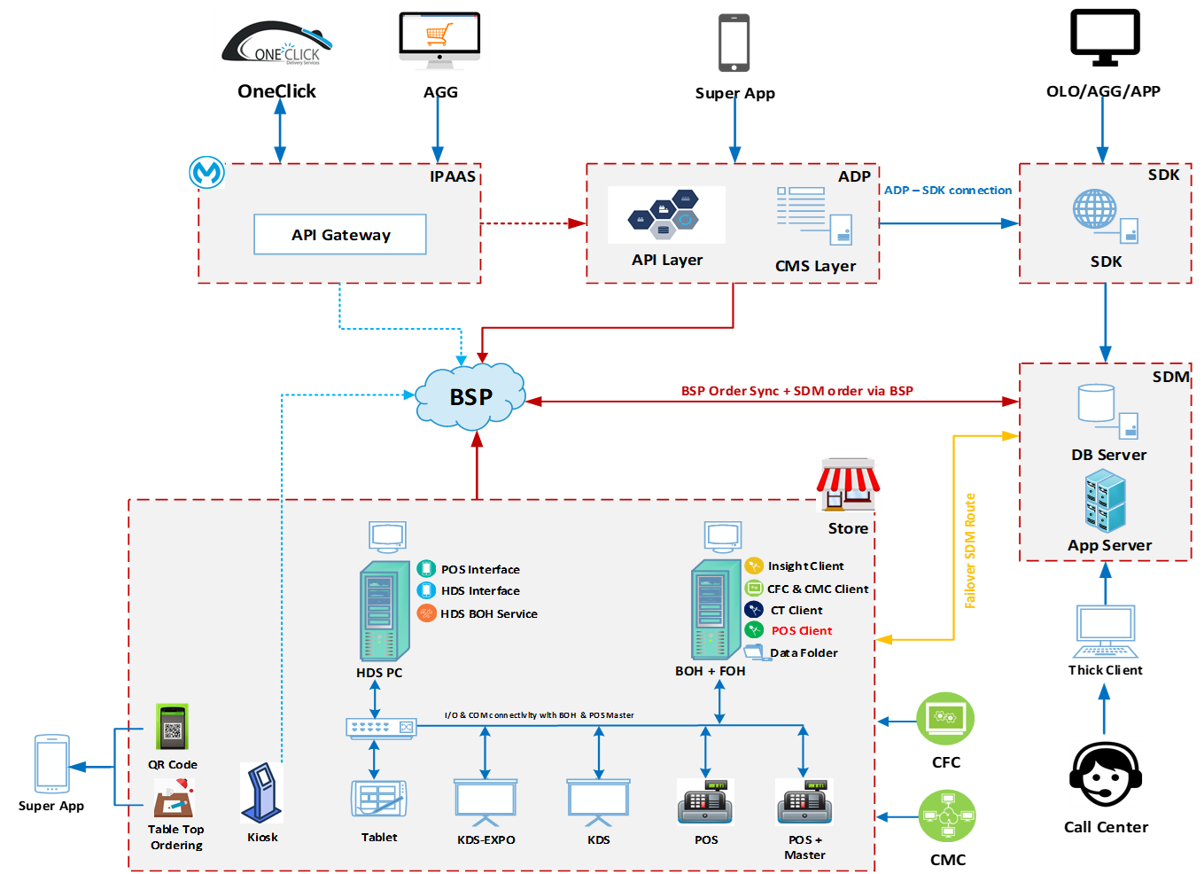




Americana Restaurants Connect (ARC)
To Be Architecture
Key Solutions
Cloud Based Services for Americana Future Needs
Developed Future Proof Scalable Cloud Solution with Near to Zero Downtime
Higher Availability & ease of Integration with Digital Channels
Automated Order Closure at POS Systems
Manpower Optimization
Reduced Risk of Fraud
Easier to Calculate Speed of Service
All Order Modes are Supported
Digital Kiosk Dine-in & Takeaway Integration
Order modes available to add revenue and digitization
Key BENEFITS (Achieved)-2022
Additional $ 500K Revenue in Q2 & Q3
Addition of 44 Stores at Digital Platforms
Additional Order Modes
Unified Multi-Country/Multi-Brand Support
Unified call-center solution

Slide 15
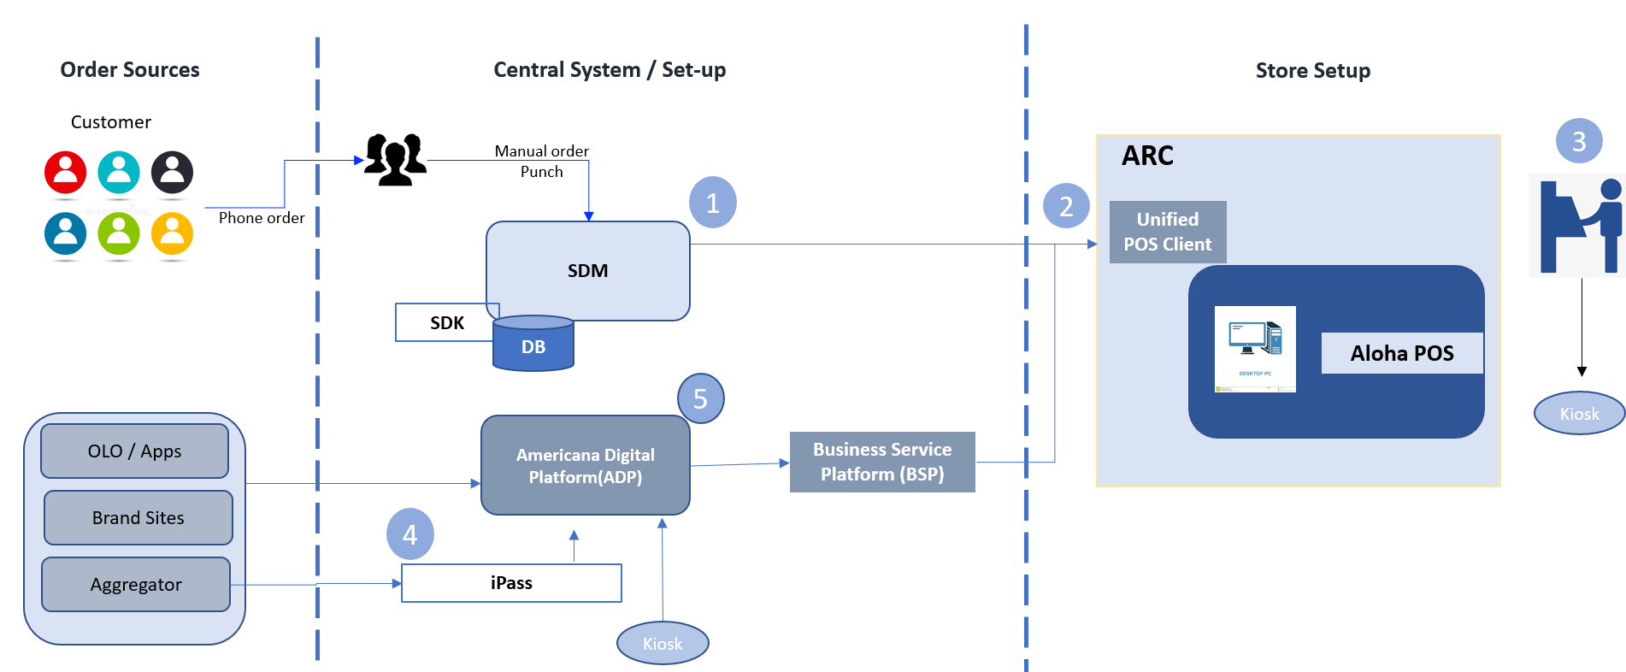
Americana Restaurants Connect (ARC)
To Be Architecture
Key Solutions
Cloud Based Services for Americana Future Needs
Developed Future Proof Scalable Cloud Solution with Near to Zero Downtime
Higher Availability & ease of Integration with Digital Channels
Automated Order Closure at POS Systems
Manpower Optimization
Reduced Risk of Fraud
Easier to Calculate Speed of Service
All Order Modes are Supported
Digital Kiosk Dine-in & Takeaway Integration
Order modes available to add revenue and digitization
Key BENEFITS (Achieved)-2022
Additional $ 500K Revenue in Q2 & Q3
Addition of 44 Stores at Digital Platforms
Additional Order Modes
Unified Multi-Country/Multi-Brand Support
Unified call-center solution

Slide 16

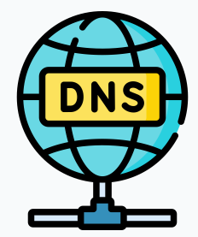
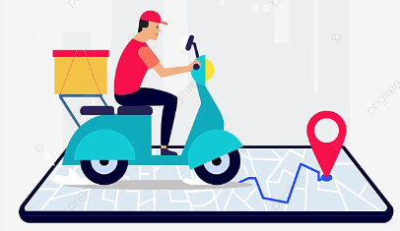






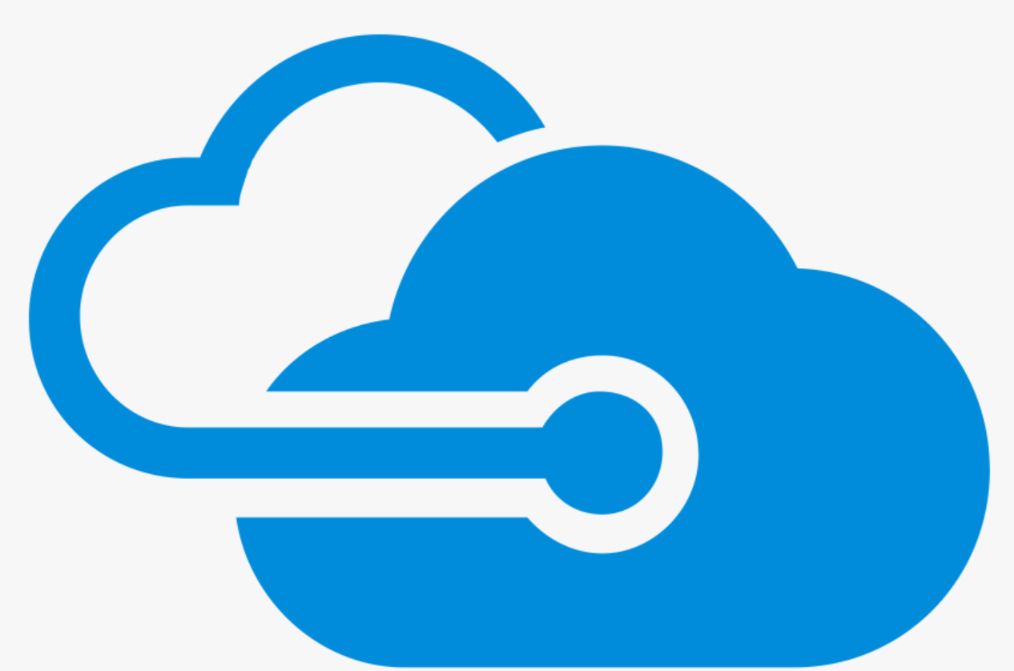




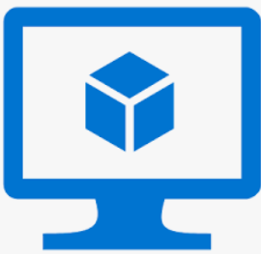
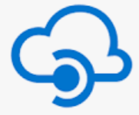
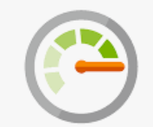





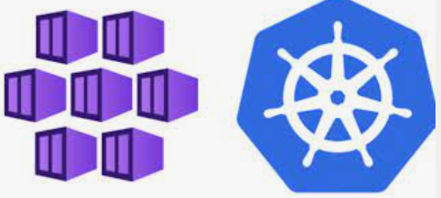



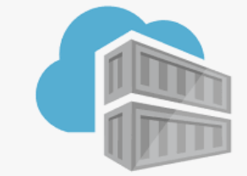



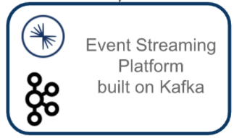

11/01/2023
ALMP Platform – Disaster Recovery Challenges
almp.americana.rest
HD Stores/
Fleet Controllers
Rider / Driver
Azure Traffic Manager
Primary region UAE North
DR region North Europe
Prod- HUB
Azure policies
Azure Firewall (HA)
UI Web VM
Azure Firewall (HA)
API
Management
Monitor
App Gateway + WAF
UI Web VM
API Management
App Gateway + WAF
vnet peering
vnet peering
Prod- Spoke
App insights
PSQL Replication
Log analytics
AKS (HA)
Storage
Account
AKS (HA)
PSQL
Redis
cache
PSQL
(Read Replica)
Storage
Account
KV
Redis
cache
KV
ACR
ACR
Azure defender
Inbound traffic from internet controlled via WAF
Outbound traffic to internet from the resource controller via Firewall

Slide 17
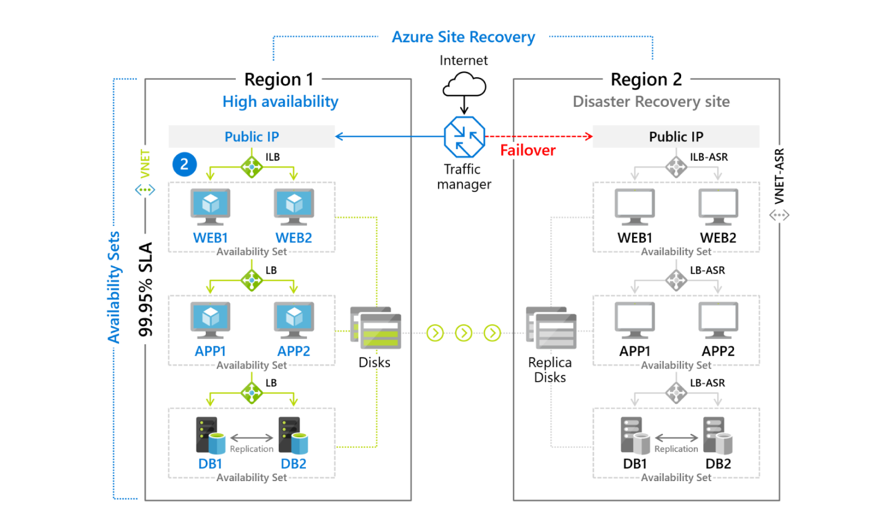

Slide 18
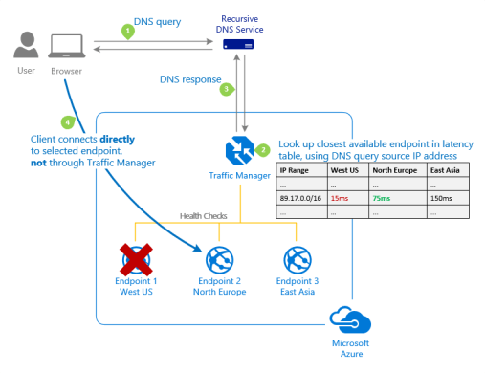
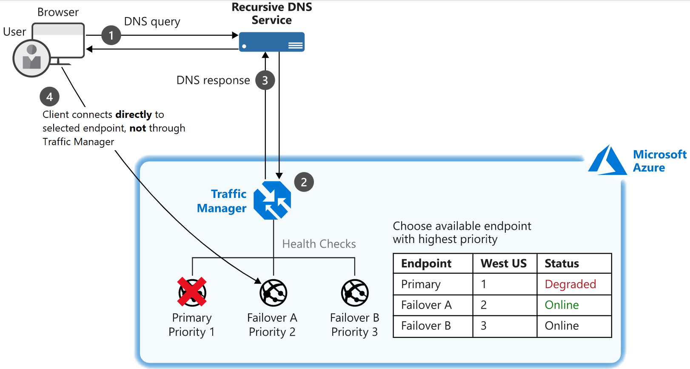
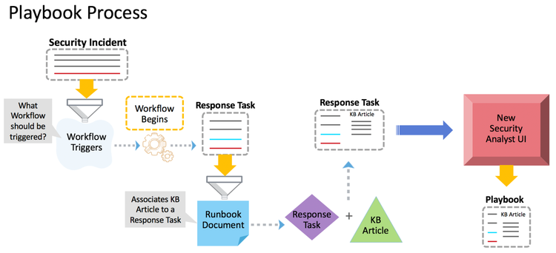
Azure Traffic Manager Workflow

Slide 19
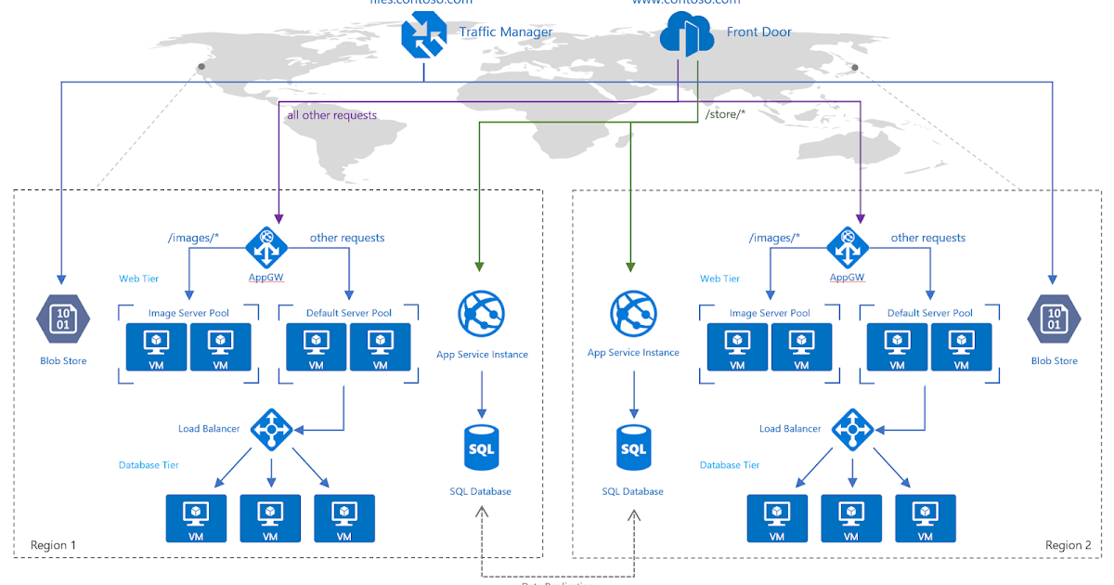
Azure Available Load Balancer Solutions

Slide 20
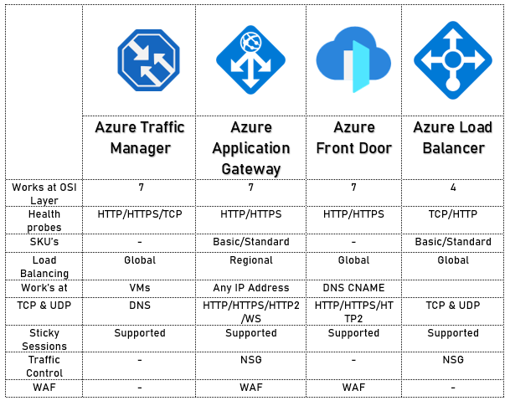
Azure Traffic Manager Alternative Solutions

Slide 21

ALMP DR Strategy with Automated/Manual Failover
Steps in the Event of Failover to DR North Europe Region
Traffic Manager validate the “Health probe” of the primary gateway needs to be whitelisted across all the Azure regions on ALMP Azure WAF which is not feasible from security perspective to open the doors globally. [Need the email confirmation from Microsoft for this feasibility issue.]
ALMP support team get alert based on New relic monitoring and alerting mechanism for a prolonged outage of ALMP application for more than 5 mins will initiate the DR runbook for failover. [Evidence from New Relic monitoring automated alert for outage and runbook for failover needed]
ALMP infra/BAU team validate the “primary” gateway health immediately enable the traffic to DR resources by “enabling” the “endpoint”. [Need team list with the roles needed]
ALMP App team team validates the data consistency” and ALMP Infra/ BAU team manually bringing the DR “replica” DB to the to “read/write”. [Need E-Mail confirmation or evidence for this manual failover]
ALMP team needs to validate the confluent topics which will be auto synced for the missed orders which was under process and not completed the order workflow and new orders or old orders during the primary impacted iPaas re-try mechanism will start working with DR cluster and continue the business. [Breakout needed what all the orders needs manual intervention]
On going transactions during failover manually need to be address if primary PostgreSQL is not available also need to treat the missed records manually which impacted slight delay with replica DB. [Need evidences for the failover delays confirmation timing]
List out the possible backend component might fail during the switchover to North Europe region. [Evidences needed per component wise if failing on DR]
Post recovery of the primary region ALMP support team will initiate and execute the runbook for failback. [Runbook for failback needed]
ALMP infra and BAU team will validate the North Europe region with all sync to the current state and enable the primary region with business continuity.
almp.americana.rest
Primary Region
Resources in
UAE North
DR Region
Resources in
North Europe

Slide 22
ALMP DR Strategy with Automated/Manual Failback
Steps in the Event of Failback to Primary UAE North Region
After the primary region (UAE North) is back to operational state, ALMP Infra/BAU team immediately initiate a replication from DR to Primary (North Europe to UAE). [Provide details of automated and manual efforts component wise with time]
ALMP team monitor the replica status and ensure the replica is up to date.
ALMP operations team update the new “replica” details to the production config map.
After a discussion with business, ALMP team bring back the production environment by performing the below takes:
Enable the Postgres DB to R/W
Validate the sanity on Confluent topics.
Run the new code to reflect the DB changes on ALMP app
Perform a complete sanity, update the missing order from DB and confluent perspective.
Resume the production option from UAE.
Post to the complete validation, ALMP team again recreate a replica from Primary to DR (UAE to North-Europe)
Update the config map in DR in line with new replica services and complete the deployment.
Update the reports module.
Perform a sanity.
almp.americana.rest
Primary Region
Resources in
UAE North
DR Region
Resources in
North Europe

Slide 23
ALMP DR Strategy Teams Roles and Responsibilities
Disaster Recovery Team with Roles and Responsibilities
ALMP Support Team
ALMP Infra Team
ALMP L2/L3 Support Team
almp.americana.rest
Primary Region
Resources in
UAE North
DR Region
Resources in
North Europe

Slide 24
ALMP DR Strategy – Intimation/Escalation Process and Stack-holders
Disaster Recovery Intimation/Escalation Processes and Stack-holders
Americana HD Team
Americana Stores Team
Americana Home Delivery Team
Americana Core Team
Cognizant Management
almp.americana.rest
Primary Region
Resources in
UAE North
DR Region
Resources in
North Europe

Slide 25
ALMP DR Strategy – Continuous Test Plan
Disaster Recovery Continuous Testing Plan
Bi-weekly DR test plan for first quarter
Monthly DR test plan for second and third quarter
Quarterly DR test plan for fourth quarter
almp.americana.rest
Primary Region
Resources in
UAE North
DR Region
Resources in
North Europe

Slide 26
ALMP DR Strategy – Runbook Expectations
Disaster Recovery Critical Systems and Data
Username and passwords for require critical resources needed for DR
Keys and login with security information
Domain registrar and DNS management details
Disaster Recovery Business Impact Analysis Details
List of digital assets impact analysis
List of API endpoints with impact analysis
List of Databases, tables, schema, relationships with impact analysis
Confluent cluster and topic level details with impact analysis
List of current SLA agreements till components level
almp.americana.rest
Disaster Recovery Escalation Plan
List out all the internal and external stockholders for escalation
Disaster Recovery Validation and Test DR Solution
Baseline recovery point objectives (RPOs) and recovery time objectives (RTO)
Disaster Recovery Review and Update DR Runbook
Review and revise frequency of DR Runbook
Primary Region
Resources in
UAE North
DR Region
Resources in
North Europe
Disaster Recovery Post Recovery Communication
RCA reports published to the stack-holders
Impacts and lesson learnt
Record and update the JIRA, Confluence for auditing and future references

Slide 27
ALMP DR Strategy – Managed and Unmanaged Activities
 | Traffic Manager
 |  | Auto switch to the DR Not Feasible | Managed Manually | By enabling the DR endpoing manually
 | Confluent Primary Failiures:
 | S. No. | Failure Use Cases/Senarios | Managed/Unmanaged | Remarks
 | 1 | Create failure | Managed in DR | Via iPaaS Retry
 | 2 | Duplicate | Managed in DR
 | 3 | Consumed/feedaback shared/Allocation/Old Orders | Unmanaged in DR
 | 4 | Partially executed order on primary cluster | Unmanaged in DR
 | PostgreSQL
 | S. No. | Failure Use Cases/Senarios | Managed/Unmanaged | Remarks
 | 1 | Read operations | Managed in DR
 | 2 | Write to the DB | Unmanaged in DR | Needs conversion to read-write
 | 3 | Delays in DB sync | Unmanaged in DR | Needs to treat orders from backend

Slide 28
ALMP DR Component RTO and RPO
High availably enablement provides additional replica instances at each component level. In the event of a component failure, Azure algorithm automatically recover the services with the available resources
S. No. | ALMP Azure Components | RPO | RTO | Availability with HA
1 | Azure Firewall | Near zero | Less than 5 mins (As per Azure SLA) | 99.99
2 | Application gateway + WAF | Near zero | Less than 5 mins (As per Azure SLA) | 99.99
3 | APIM | Near zero | Less than 5 mins (As per Azure SLA) | 99.99
4 | UI VM (Zone1 and Zone2) | Near zero | Less than 5 mins (As per Azure SLA) | 99.99
5 | AKS | Near zero | Less than 5 mins (As per Azure SLA) | 99.99
6 | Postgres Flexi server (Zone1 and Zone2) | Near zero | Less than 5 mins (As per Azure SLA) | 99.99
7 | Redis Cache | Near zero | Less than 5 mins (As per Azure SLA) | 99.95
8 | Key Vault | NA | NA | NA
9 | Container registry | NA | NA | NA
10 | Storage accounts | Near zero | Less than 5 mins (As per Azure SLA) | 99.99

Slide 29
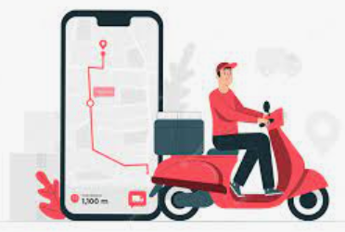
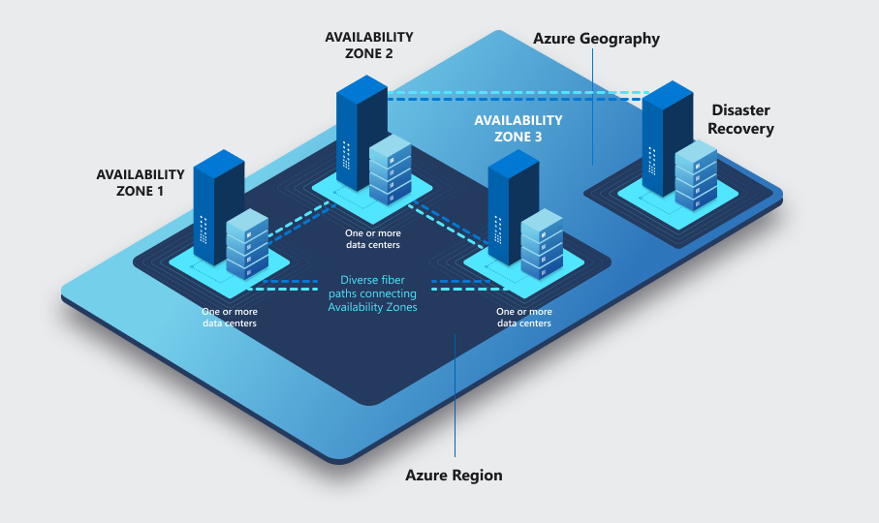
ALMP Infrastructure HA and DR Overview
High Availability – Status Summary
Additional Cost of HA 71% on Prod
Infra | Service | Risk | HA | Testing & SLA
iPaaS | MuleSoft Multi Worker Nodes | High | Enabled | AWS/MuleSoft SLA
Confluent | Kafka Streaming - MultiZone | High | Enabled | Standard MZ SLA
Database | Azure PostgreSQL Flexi Server​ | High | Enabled | Microsoft SLA # 42
Dashboard | Dual VM for Store & Order Tracking WebUI | High | Enabled | Microsoft SLA + VM Switch over test
Gateway | Gateway & APIM​ | Medium | Enabled | Microsoft SLA
Network | Azure Network Backbone​ | Low | Enabled | Microsoft SLA
Security | Firewall / Security layer​ | Low | Enabled | Microsoft SLA
Microservices | Azure Kubernetes & Ingress | Low | Enabled | Microsoft SLA
Sectigo CA | SSL Certificate | Low | Planned | New CA Authority
Route Mobile | SMS Services | Low | Planned | New SMS Services
GIS Services | Google Maps Services | Low | Planned | Map Overlay Services
Firebase | Push Notification | Low | Planned | Advanced Push Notification Services
ALMP DR | Single Availability Zone | Low | In-Progress | Microsoft SLA + UAT Testing
Backup & Restore | Data Backup & Restore | Low | Planned | AWS/Data Lake
HD Stores/
Fleet Controllers
Rider / Driver
ALMP Traffic Manager
ALMP DR – North Europe
ALMP Primary – UAE North
RPO: 30 min
ETA: May 31, 2023
ETA: 5th June 2023
100 % Completed
90% Completed.
RTO: 60 min
Governance Team
Process flow – Architectural Governance Process
Role | Team | POC/SME
Contributor | ALMP Infra team | Saravanan, Ameer and Mangesh
Reviewer-1 | Microsoft | Microsoft SME’s
Reviewer-2 | CTS MBG team | CTS MBG
Reviewer-3 | Americana | Vinod (Architecture and Resourcing) Siyad (Quality Assurance)
Final Approval | Americana | Vinod and Dheeraj
Architecture plan
Review 1 - Microsoft
Review 2 – CTS MBG
Review 3 – Americana SME
Process flow – Resourcing Decision Approval Process
Creator- CTS team
Facilitator- Americana (Vinod)
Approver
Dheeraj
Implementer
CTS infra team
Ref: Confluent Cloud Cluster Service Level Agreement
Ref: Service Level Agreement for Microsoft Online Services

Slide 30
Prod Architecture Active- Passive and DR RPO and RTO
Most of the Azure components supports “High availably” and provides 99.99 availability in UAE North region.
In the event of region failure, the “Posgres SQL” replication needs to be disabled manually to bring the target
to Read/Write.
Expected RPO/RTO 30 mins and 60 mins.
Note : The paired region for “UAE North” is “UAE Central”, however Americana looking for a DR to be placed in
a different country to ensure the business to withstand during catastrophic event.
Moreover, from Microsoft front they don’t have region available for new customer. To consider all the concerns the
“North Europe region considered as a DR.
DR test planning updated here.
Confluent active/passive DR details updated here.

Slide 31
Prod Architecture regional RPO/RTO
Front end | RPO | RTO | Availability with HA
Azure Firewall | Near zero | Less than 5 mins (As per Azure SLA) | 99.99
Application gateway + WAF | Near zero | Less than 5 mins (As per Azure SLA) | 99.99
APIM | Near zero | Less than 5 mins (As per Azure SLA) | 99.99
UI VM (Zone1 and Zone2) | Near zero | Less than 5 mins (As per Azure SLA) | 99.99
AKS | Near zero | Less than 5 mins (As per Azure SLA) | 99.99
Postgres Flexi server (Zone1 and Zone2) | Near zero | Less than 5 mins (As per Azure SLA) | 99.99
Redis Cache | Near zero | Less than 5 mins (As per Azure SLA) | 99.95
Keyvault | NA | NA | NA
Containter registry | NA | NA | NA
Storage accounts | Near zero | Less than 5 mins (As per Azure SLA) | 99.99
High availably enable provides additional replica instances at each component level.
In the event of a component failure, Azure algorithm automatically recover the services with the available
resources

Slide 32
ALMP failback Srtragey
Failback
After the primary region (UAE North) is back to operational state, ALMP Infra/BAU team immediately
initiate a replication from DR to Primary (North Europe to UAE).
2) ALMP team monitor the replica status and ensure the replica is up to date.
3) ALMP operations team update the new “replica” details to the production config map.
4) After a discussion with business, ALMP team bring back the production environment by
performing the below takes.
Enable the Postgres DB to R/W
Validate the sanity on Confluent topics.
Run the new code to reflect the DB changes on ALMP app
Perform a complete sanity, update the missing order from DB and confluent perspective.
Resume the production option from UAE.
5) Post to the complete validation, ALMP team again recreate a replica from Primary to DR (UAE to
North-Europe)
6) Update the config map in DR in line with new replica services and complete the deployment.
7) Update the reports module.
8) Perform a sanity.
almp.americana.rest
Primary region
resources
DR region
resources

Slide 33
ALMP DR Srtragey with Automated Failover
In the event of DR
1) Traffic Manager validate the “Health probe” of the primary gateway.
2) Traffic manager detects a health probe Tolerated number of failures more
than a defined time (15 mins) the DNS traffic automatically route the
traffic to DR gateway and trigger the alert.
3) ALMP App team team validates the data consistency” and ALMP Infra/ BAU team manually
bringing the DR “replica” DB to the to “read/write”.
4) ALMP team validate the confluent topics and take a necessary action for the missed order
to provide a go-ahead to resume business.
5) On going transactions during failover manually need to be address if primary is not responsive
both DB and Confluent.
6) After the DR failover, the new transactions will flow to DB and confluent
7) DR cluster resources should be up and running with all required configs related to DR
Note: Above mentioned automated failover only deals with the “Front end”
component failures, There are scenario on the backend components failures, like DB
or Confluent failures still we need to perform a manual failover based on the validation.
High availability feature is not enabled on DR due to cost
almp.americana.rest
Primary region
resources
DR region
resources

Slide 34
ALMP DR Srtragey with manual Failover
In the event of DR
1) Traffic Manager configured such way to ignore the “Health Probe” and direct
all the traffic to Primary region (UAE)
Support team get alert based on New relic monitoring and alerting mechanism for a prolonged
outage of ALMP application for more than 5 mins,
ALMP infra /BAU team validate the “primary” gateway health enable the traffic to DR resources
by “enabling” the “endpoint” .
ALMP operations team validate the “data consistency” and ALMP Infra/BAU team manually
bringing the DR “replica” DB to “read/write”.
5) ALMP operations team validate the confluent topics, performing the take a
necessary action for the missed order to provide a go-ahead to resume
business.
6) On going transactions during failover manually need to be address
if primary is not responsive both DB and Confluent.
7) After the DR failover, the new transactions will flow to DB and confluent
8) DR cluster resources should be up and running with all required configs
related to DR
Note: Above mentioned automated failover only deals with the “Front end”
component failures, There are scenario on the backend components failures, like DB
or Confluent failures still we need to perform a manual failover based on the validation.
No HA enabled on DR due to cost.
almp.americana.rest
Primary region
resources
DR region
resources

Slide 35
Third party components
Vendor | HA | DR
Google Map | Need to validated by Americana | Need to validated by Americana
google fire services | Need to validated by Americana | Need to validated by Americana
mobile - payment gw | Need to validated by Americana | Need to validated by Americana
confluent | enabled | enabled
SMS integration | Need to validated by Americana | Need to validated by Americana
acu weather | Need to validated by Americana | Need to validated by Americana

Slide 36
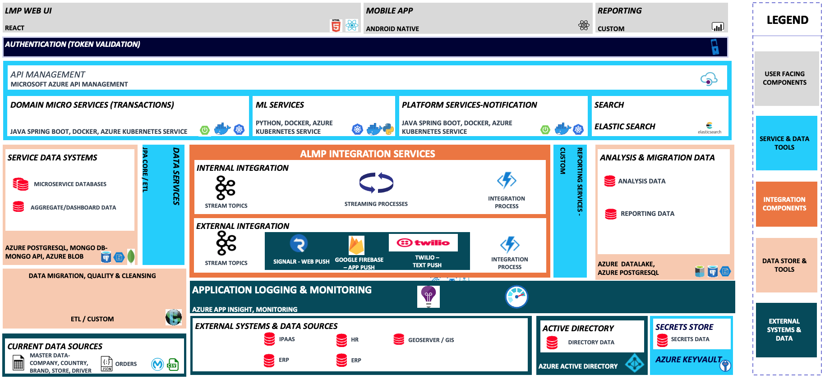
ALMP Platform – High Level Design

Slide 37
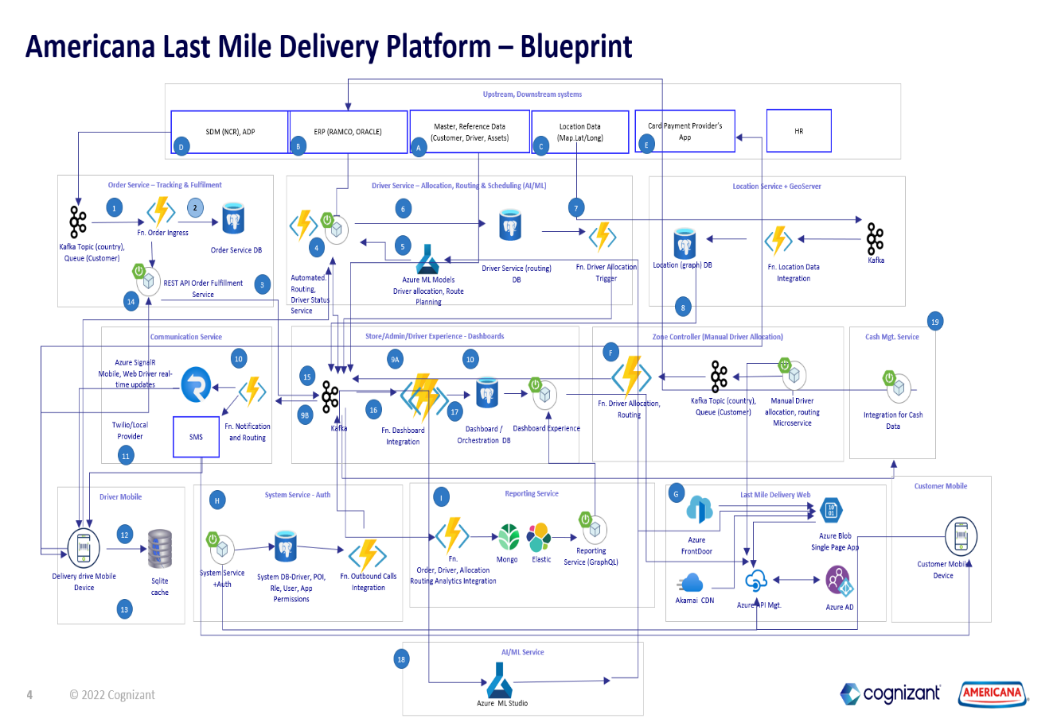

Slide 38
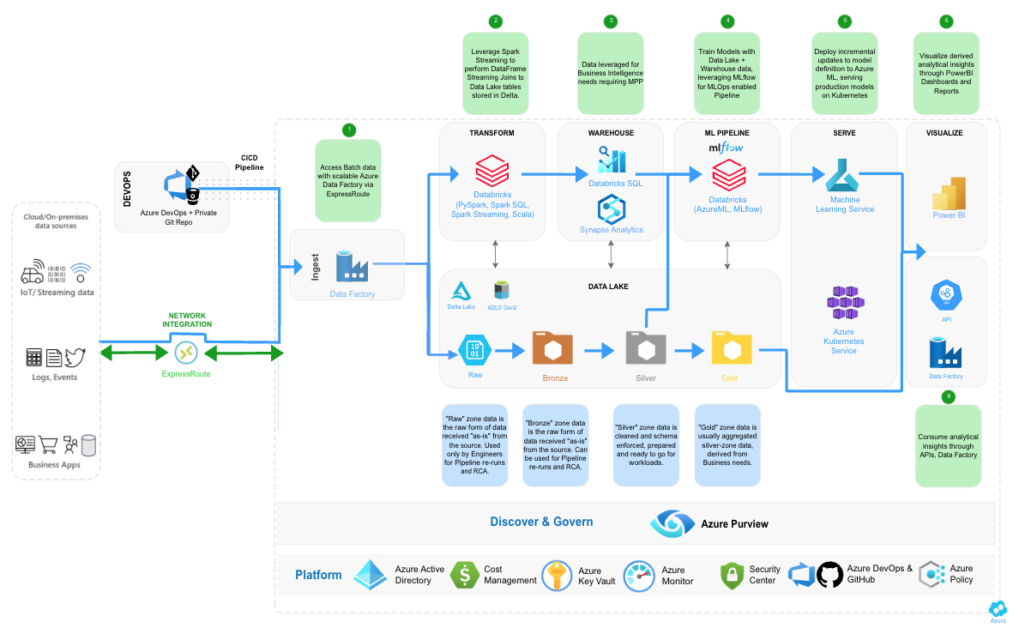
ALMP Data Platform Architecture - Proposed

Slide 39
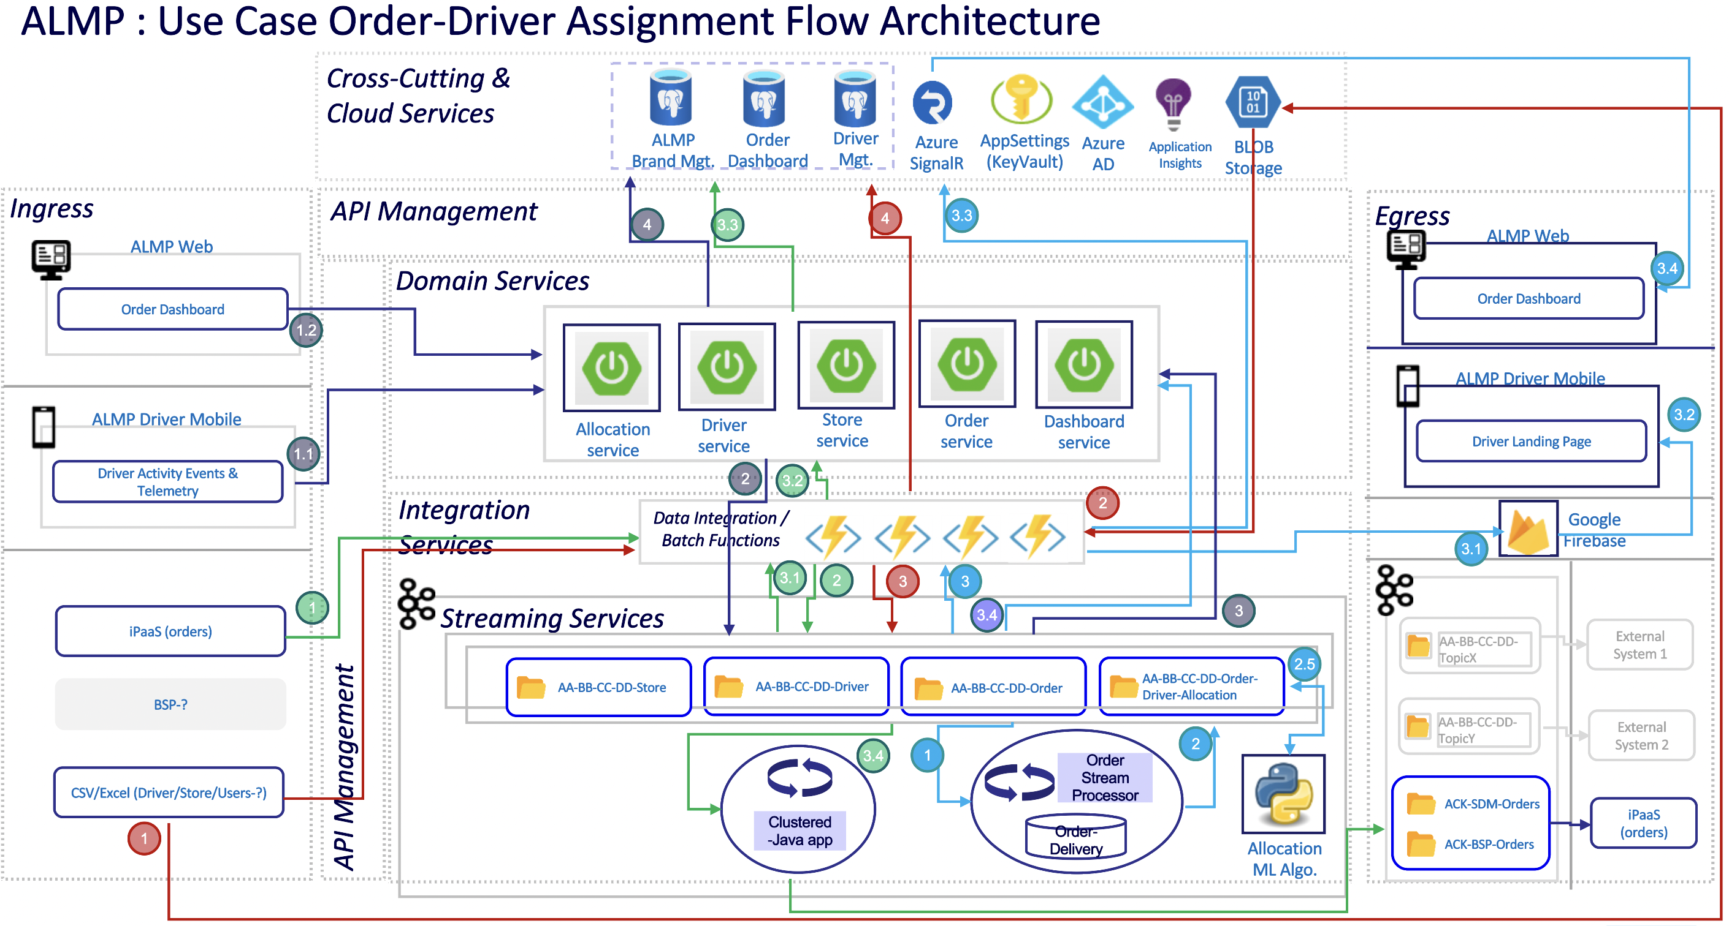
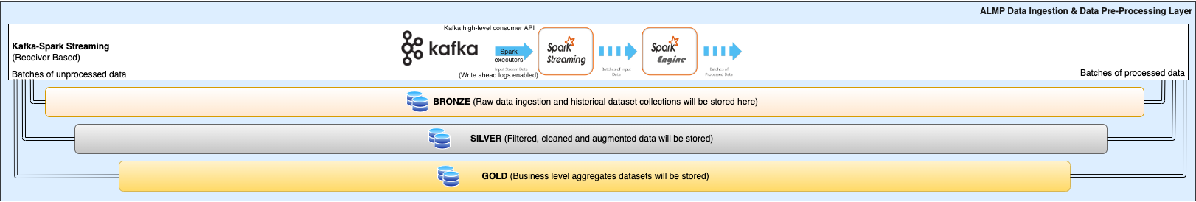
ALMP Data Platform Expansion (Next Phase)

Slide 40
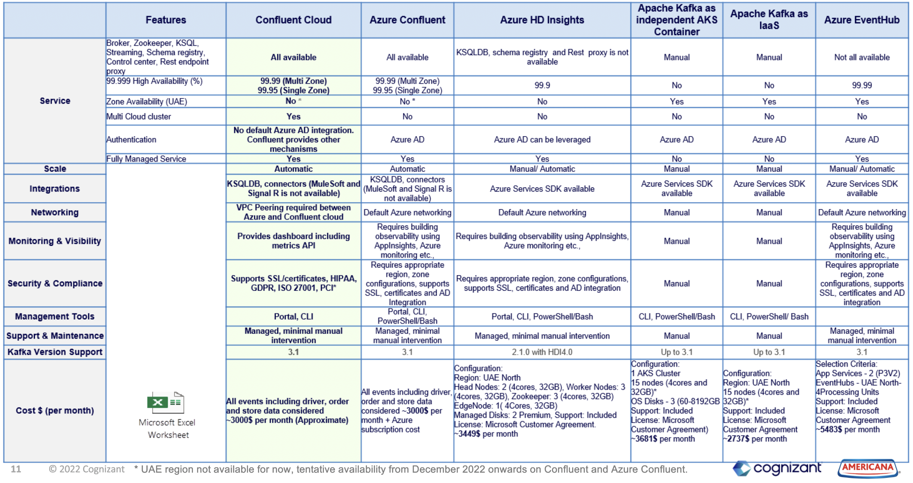
Kafka Event Streaming for ALMP – Available Solutions and Selection Criteria​

Slide 41
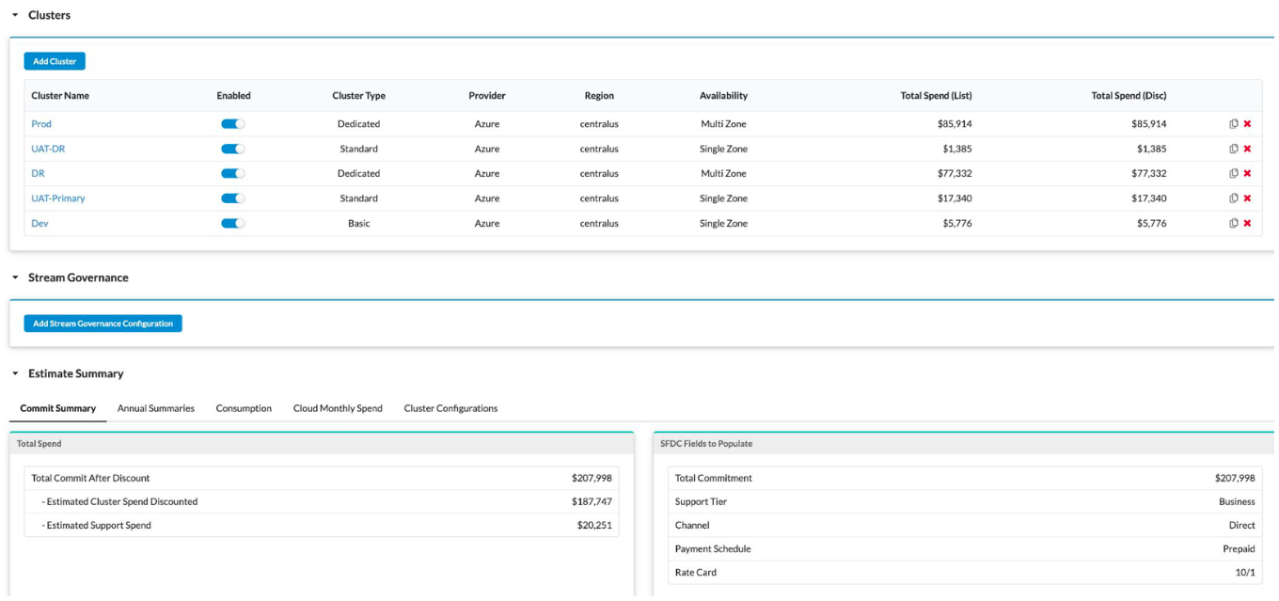
Confluent – Summary

Slide 42
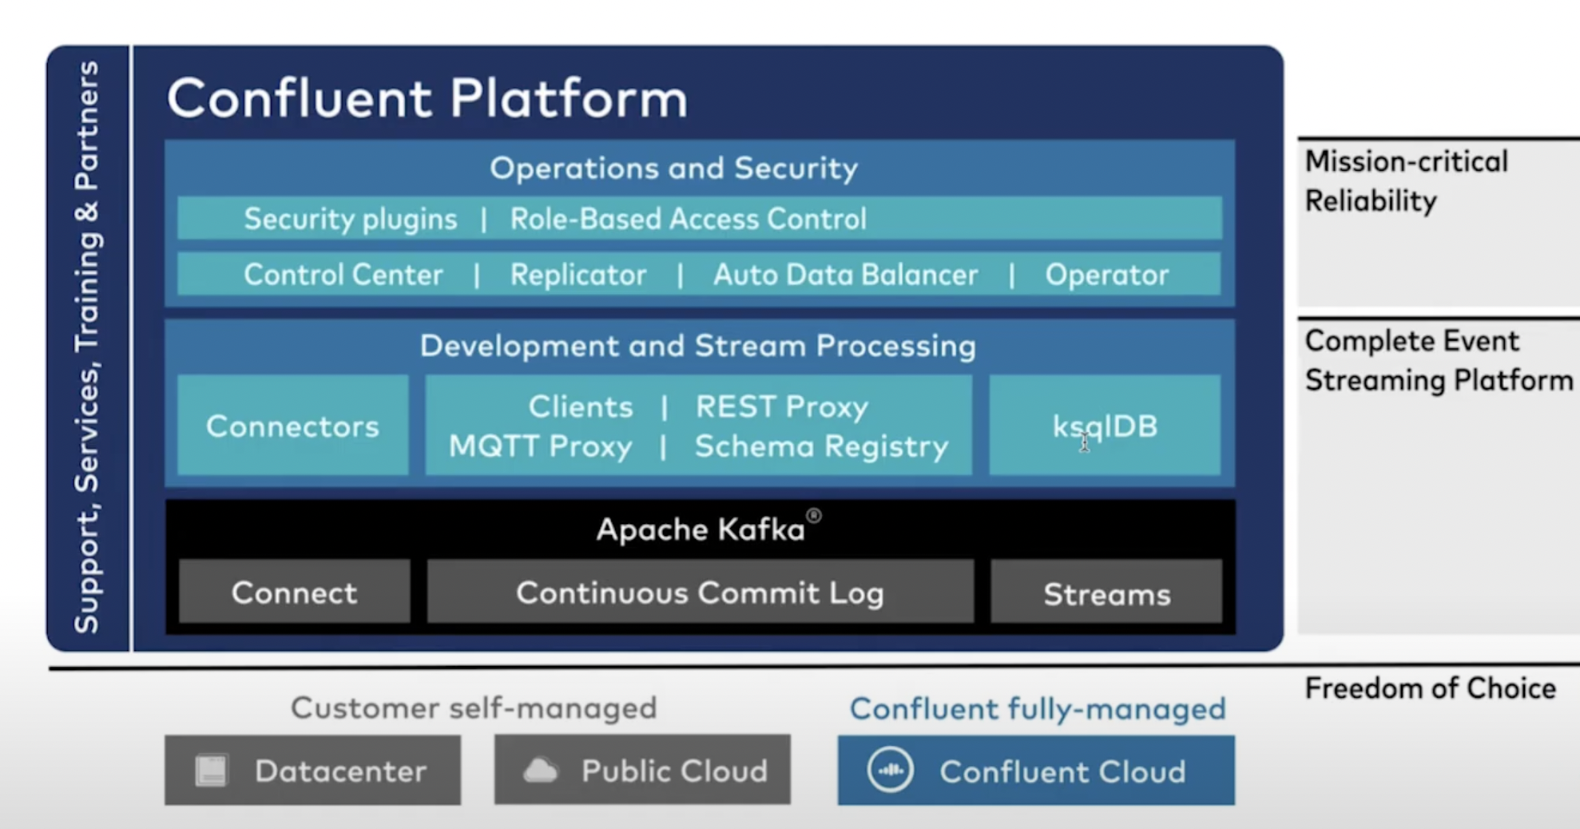
ALMP Kafka Event Streaming – Confluent Cloud Features

Slide 43
ALMP Database Requirements
ALMP system has data types with structured, semi-structured and unstructured for that need below are the data storage solutions which needs to be used with cloud services:
Type of Usages | Data Storage Types | Suggested Solutions | Remarks
Transactions (OLTP) | Relational/No-SQL | PostgreSQL/MongoDB
Analytics (OLAP) | Columnar | Azure Synapse
Dictionary | Key-Value | Redis
Cache | In-memory | Redis
2-D Key Value | Wide Column | Cosmos DB/MongoDB
Time Series | Time Series | Cosmos DB/MongoDB
Audit Trail | Immutable Ledger | Azure SQL
Location & Geospatial | JSON Data | Cosmos DB/MongoDB
Entity Relationship | Graph | Cosmos DB/MongoDB
Nested Objects (XML, JSON) | Documents | Cosmos DB/MongoDB
Full Text Search | Text Search | APIs
Rich Text | Blob | Cloud Storage
Data Lake | All | Azure Data Lake/MongoDB Data Lake

Slide 44
ALMP Infrastructure Design

Slide 45
Americana Last Mile Platform – Infrastructure Design Environments
Cloud design consists of the various cloud resources as part of the ALMP platform design which is managed via below environments
ALMP Users
HUB Subscription – Considered as a DMZ network contains public-facing services and is designed to help protect the internal networks.
Non-Prod Subscription – Contains non-production (Dev/QA/UAT) environment resources
Production Subscription – Comprised of Production environment resources
DR HUB Subscription – Provisioned in a different region it acts as a DMZ (Demilitarized Zone) network for DR resources.
DR Prod Subscription – Acts as a DMZ for DR resources.
DNS
Routed to DR if UAE North DC Failed
2. Central Hub Subscription
5. DR Subscription
Prod Hub
DR Hub
UAE North(Primary)
UAE Central
1. DEV
4. Pre-Prod
6. Disaster Recovery
2. QA
5. Prod
3. UAT
1. Non-Prod Subscription
3. Production Subscription
4. DR Subscription
DR region will be decided with the prod during the launch at the end of year 2022.
The list of resources which is common for non-prod and prod is in discussion with partner which consists of Firewall, KeyVault and other common cloud services.

Slide 46
Americana Last Mile Platform – Infrastructure Design Environments
Cloud design consists of the various cloud resources as part of the ALMP platform design which is managed via below environments
Platform Users
HUB Subscription – Considered as a DMZ network contains public-facing services and is designed to help protect the internal networks.
Non-Prod Subscription – Contains non-production (Dev/QA/UAT) environment resources
Production Subscription – Comprised of Production environment resources
DR HUB Subscription – Provisioned in a different region it acts as a DMZ (Demilitarized Zone) network for DR resources.
DR Prod Subscription – Acts as a DMZ for DR resources.
DNS
Routed to DR if Region-1 DC Failed
2. Central Hub Subscription
5. DR Subscription
Prod Hub
DR Hub
Region-1
Region-2
1. DEV
4. Pre-Prod
6. Disaster Recovery
2. QA
5. Prod
3. UAT
1. Non-Prod Subscription
3. Production Subscription
4. DR Subscription
DR region will be decided with the prod during the launch at the end of year 2022.
The list of resources which is common for non-prod and prod is in discussion with partner which consists of Firewall, KeyVault and other common cloud services.

Slide 47
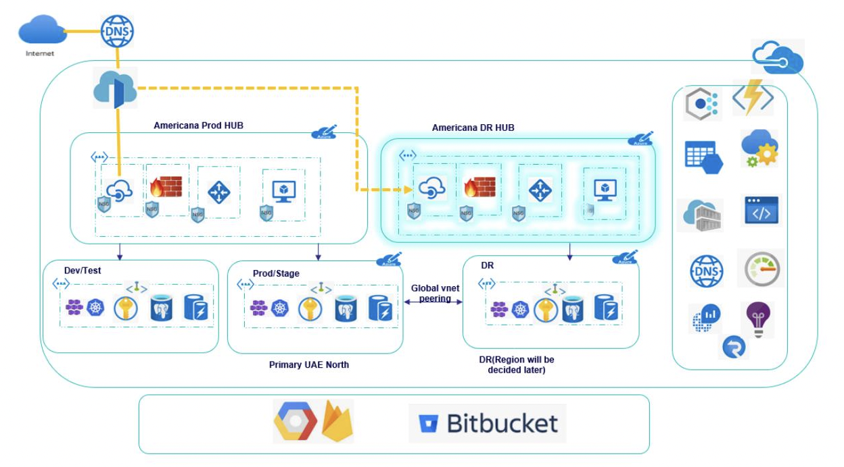
ALMP Infrastructure Landscape Diagram with Environments

Slide 48
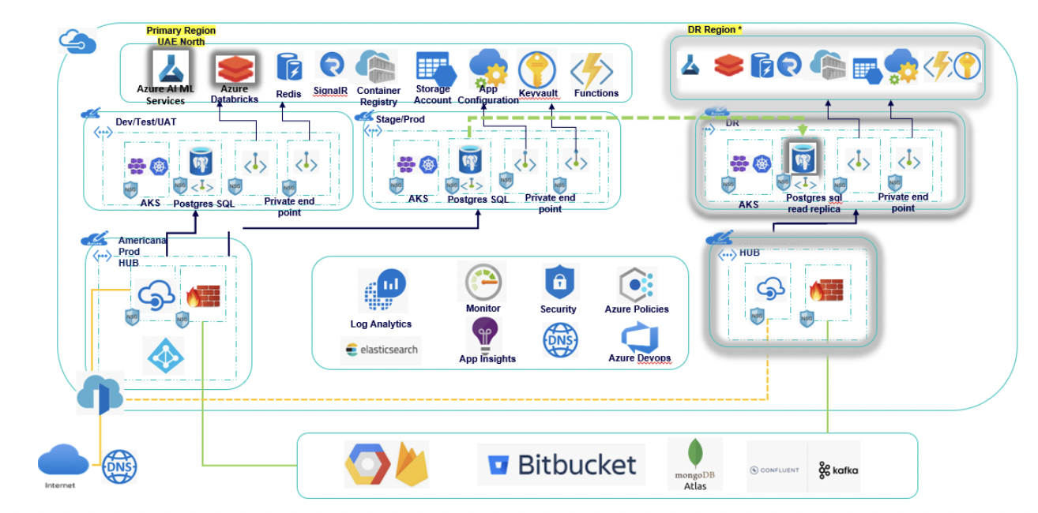
ALMP Infrastructure – Logical Architecture

Slide 49
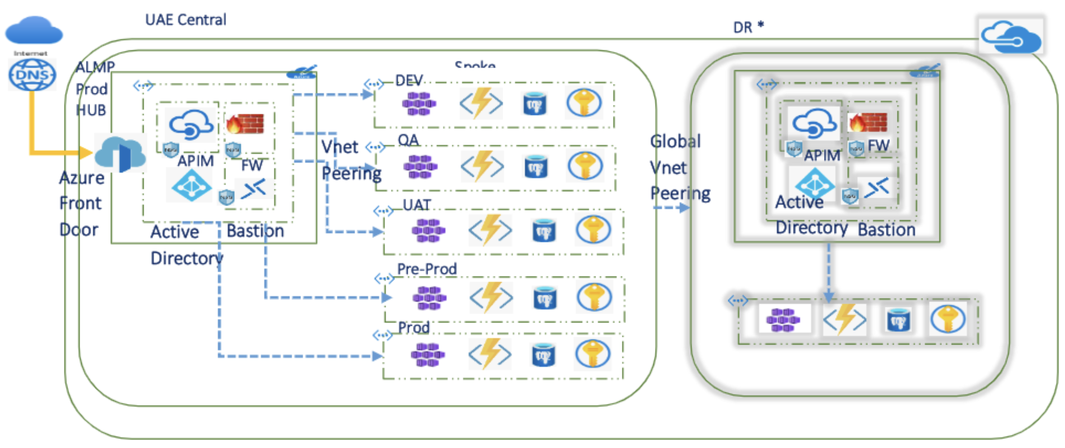
ALMP Platform – Cloud Deployment Design

Slide 50
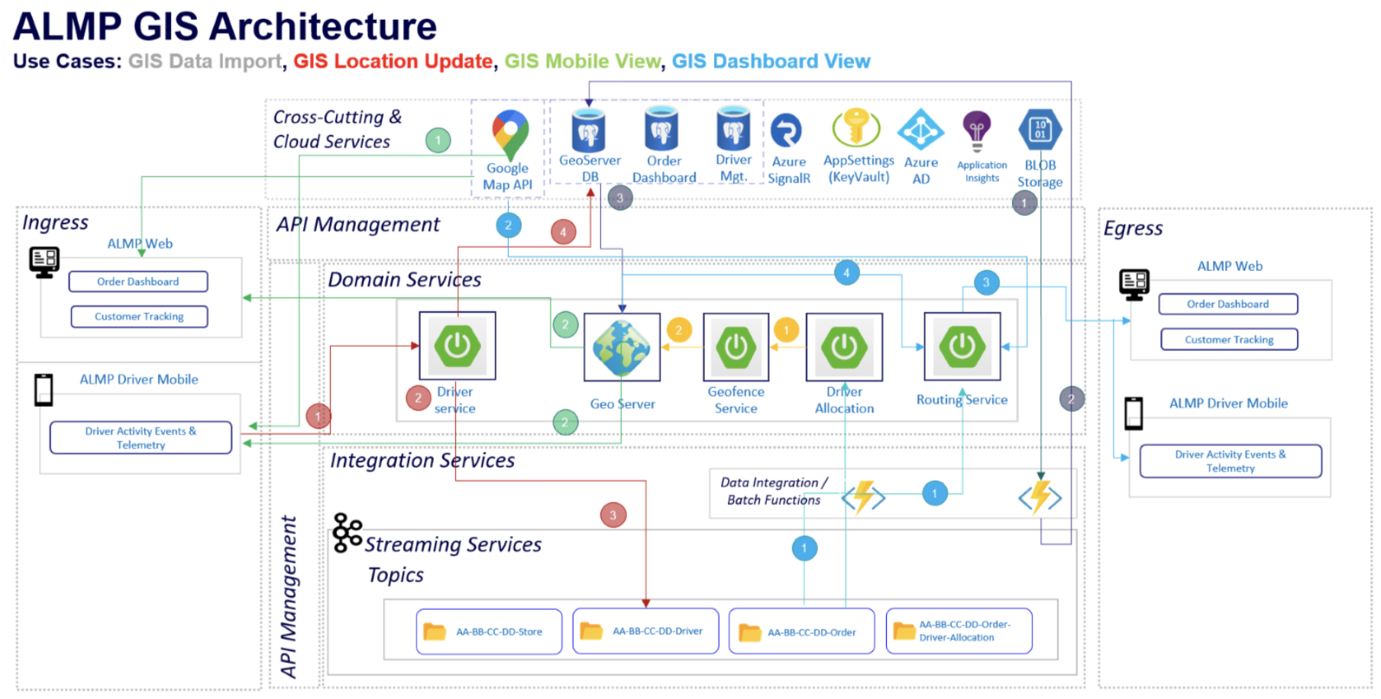

Slide 52
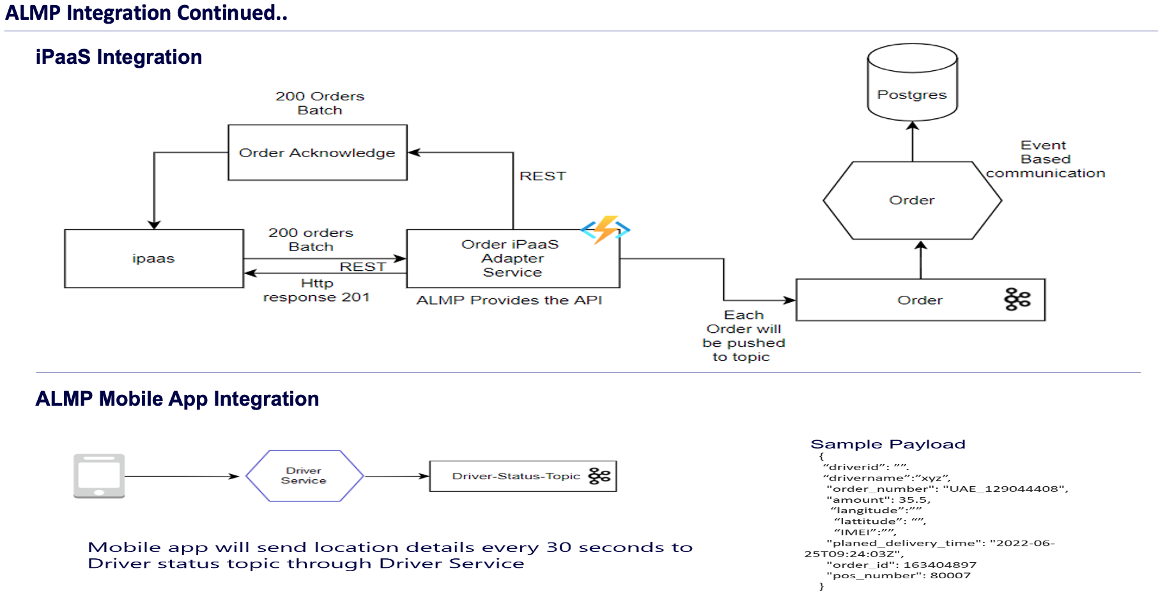

Slide 53
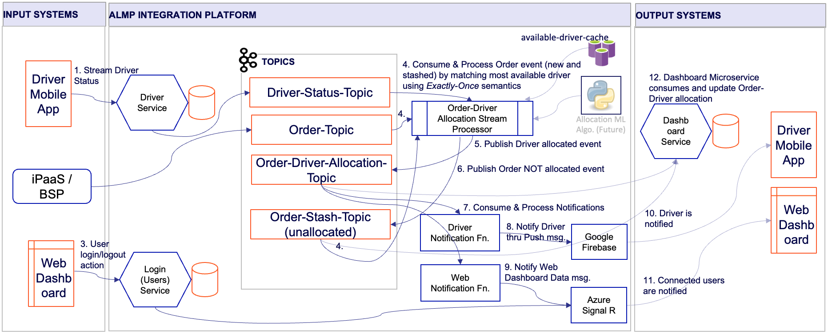
ALMP Platform – Order Data Ingestion Workflow

Slide 54
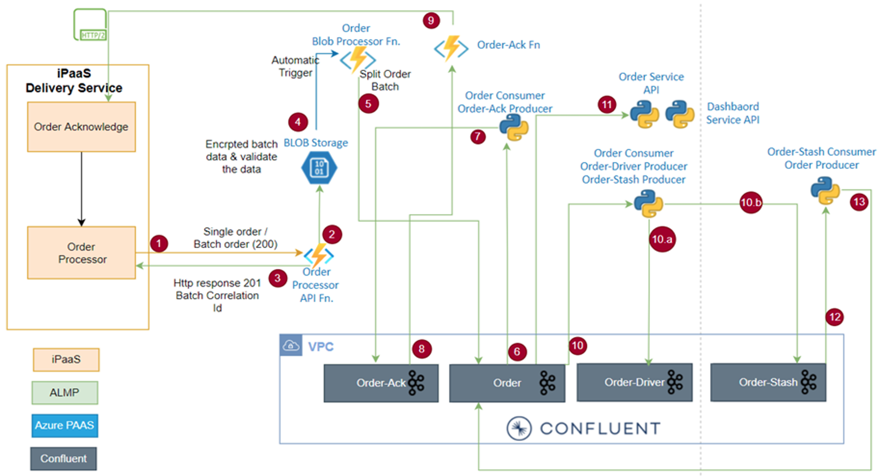

Slide 55
ALMP CI/CD Design

Slide 56
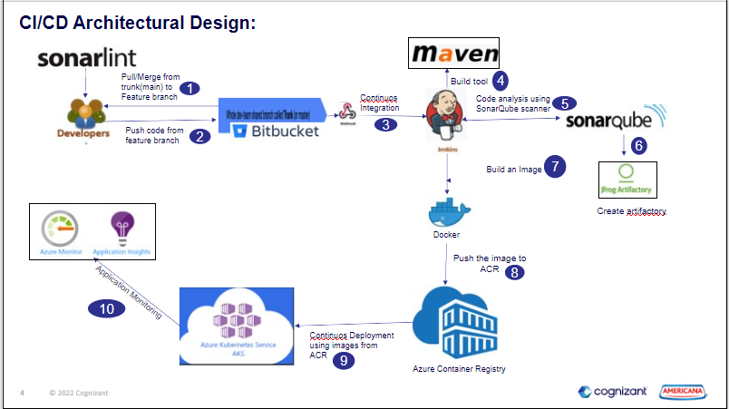

Slide 58
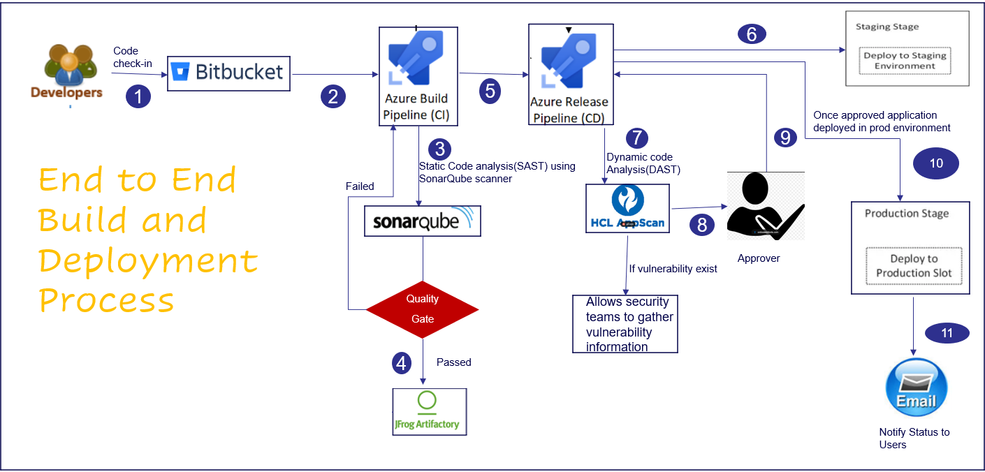

Slide 59
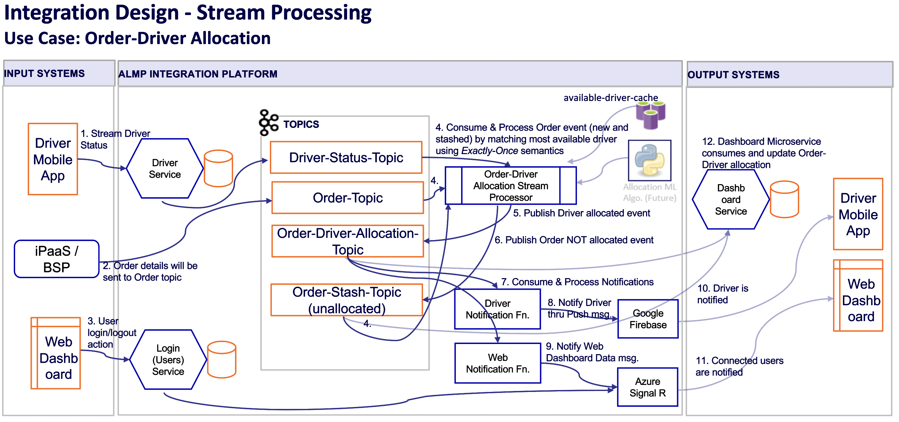

Slide 60


Slide 61


Slide 62


Slide 63

Order Events Streaming using Kafka – Confluent Cloud Workflow

Slide 64


Slide 65


Slide 67
ALMP Azure Deployment Architecture

Slide 68


Slide 69
GIS Architecture

Slide 71


Slide 72


Slide 73
THANK YOU

Slide 74


Slide 75

Technical Architecture 1.0
1
Akamai CDN
ALMP system is multi-country and increased latency means websites and apps are slow to load this will be resolved via Akamai CDN. ALMP Load Testing, Real time user monitoring, Real time logs insights will help in continuous improvement in the system infra.
2
Backend - Microservices
1
Multithreading capabilities of Java and faster way to build microservices in SpringBoot will benefit us on performance and speed up in development.
ALMP system is multifunctional and complex app where concurrency will be higher and can be well managed using multi-threaded and distributed load.
3
In-Memory Data Store
2
In-memory key-value data structure store for the usage of the database, cache, and message broker and queue.
Elastic indexes are used to store all published data along with recommended items and placed order queries.
7
4
Database
3
MongoDB is faster than relational DBs due to its ability to handle large amounts of unstructured data when it comes to speed.
Very flexible in terms of design, dynamic schema, less risk of attack due to design.
6
5
Kafka Steams
4
To achieve high throughput in streaming events between read and write repositories of order management, sending real time or batch events to recommendation engine and publishing approved catalog and products like menu and foods to elastic index.
5
6
Azure Active Directory
Will be storing all registered user credential to manage authentication and authorization.
7
Data Lake
Advanced Analytics and Cognitive Intelligence on Petabyte sized files and trillions of objects with Data Lake.
8
Third Party Integrations
Google Firebase for user journey, driver app crashlytics, FCM. Swagger for API documentation and mocking, SonarQube for SAST scanning, Veracode for DAST scanning and Kubernetes for automating deployment, scaling, and management of containerized applications.
Notes:
The technical architecture for ALMP platform is an indicative and high level design which is aligned with the existing ADP technical stack. The indicative architecture already being shared with the RFP documentation to all the partners withing the functional and non-functional requirements.
Partners are free to choose the new technical stack based on the best fitment to solve the problems on the ALMP requirements by justifying the need for the change in technology and implementation modes.

Slide 76


Slide 77
Apache Kafka – Availability and Options
The case study for Confluent Kafka usage in ALMP after comparing Kafka on VM, EventHub, Kafka on AKS, Confluent Cloud and HD Insights
Apache Kafka on VM – ADP is using this strategy to manage the event streaming along with the RabbitMQ.
EventHub – Power BI Reporting team is using this strategy and facing version compatibility issues.
Kafka on AKS – Self managed where cost of operator + infrastructure cost is required.
Confluent Cloud – Selected for ALMP Proof-of-Concept and evaluating.
HD Insights – Apache Kafka Compatibility and Support up to 2.1.0 version.
Confluent enables you to connect on-prem and multi-cloud data to services like Azure Synapse, CosmosDB, Data Lake Gen 2 storage, and tech partners running on Azure like Snowflake, Elastic, and MongoDB. Running Confluent alongside these key services allows enterprises to quickly connect and process real-time data to power new analytics and applications.
Cloud-Native: Apache Kafka, completely re-architected for the cloud. Our fully managed, elastic, and globally available service is deeply integrated with Azure security, management, services, and billing, while allowing you to cost-effectively retain data at any scale with Infinite Storage.
Complete: Go above and beyond Kafka to build real-time apps quickly, reliably, and securely with pre-built and fully managed connectors, stream governance, stream processing powered by ksqlDB, built-in management & monitoring, and enterprise-grade security.
Everywhere: Connect and migrate on-prem, multi-cloud, and edge data to Azure, and seamlessly link everything all together in real-time to create a consistent data layer across your business with Cluster Linking.

Slide 78


Slide 79


Slide 80

Technical Architecture 2.0
1
2
3
4
5
6
7
8
9
10
1
Frontend – Mobile & Web Dashboards
5
API Gateways
9
DB and SDKs
Platform user interfaces for the end users which includes driver android app, store dashboards and other internal dashboards.
Azure API Management will helps in meeting the challenges like abstract backend architecture diversity and complexity from API consumers, Securely expose services hosted, protect, accelerate, and observe APIs.
The existing data sources which is available inside the SDM and available via SDKs or APIs to integrate.
2
CDN & WAF
6
Microservices
External/Third Party Systems
For latency, reliability and traffic spikes will be managed by putting the critical servers behind the CDN layer. Also, WAF policies will be enabled to secure the APIs and infrastructure.
10
The microservices will be separated based on the requirements and usage to route the requests to the respective APIs.
This is the future external and third-party system integration layer which is available to fetch data from any type of system and execute the last mile delivery system.
3
Primary Environment
7
DB and Storage
The active environment will always available, and all the application requests will be served via the primary environment.
The DB and storage is designed in three layered secured and 99.999% response availability for the requests made for the data.
4
Secondary Environment – active/passive
8
Event Streaming Platform
For the disaster recovery strategy we are planning to use active/passive where all the critical resources will be backed-up to different region with replications and synced data.
For event streaming and real time data ingestion Kafka will be used which has further exposed in the next upcoming slides.
Notes:
Technical architecture 2.0 is the new updates and revised diagram with deep dive on various technical layers by applying different tricks and techniques to achieve higher performance and availability with cost optimizations.

Slide 81

Technical Architecture 2.0 - Frontend Dashboards
1
Web Dashboards with Real DOM
2
ALMP system web based dashboard application which will be developed in React.js. The modules will be listed as Store Dashboard, Command Centre, Driver Management, Cashier Dashboard, Admin Dashboard and Analytics Dashboard.
1
2
Virtual DOM
Multithreading capabilities of Java and faster way to build microservices in SpringBoot will benefit us on performance and speed up in development.
ALMP system is multifunctional and complex app where concurrency will be higher and can be well managed using multi-threaded and distributed load.
4
5
6
3
React Components
3
In-memory key-value data structure store for the usage of the database, cache, and message broker and queue.
Elastic indexes are used to store all published data along with recommended items and placed order queries.
10
9
8
7
4
User Interactions and Actions
MongoDB is faster than relational DBs due to its ability to handle large amounts of unstructured data when it comes to speed.
Very flexible in terms of design, dynamic schema, less risk of attack due to design.
11
5
Action Creators
To achieve high throughput in streaming events between read and write repositories of order management, sending real time or batch events to recommendation engine and publishing approved catalog and products like menu and foods to elastic index.
9
Effects
12
APIs
6
Dispatchers
Will be storing all registered user credential to manage authentication and authorization.
API requests will be made by the frontend using Redux Saga layer at step 8 and response will be received back from the API endpoint.
Will be storing all registered user credential to manage authentication and authorization.
10
Reducer
7
Actions
Advanced Analytics and Cognitive Intelligence on Petabyte sized files and trillions of objects with Data Lake.
Advanced Analytics and Cognitive Intelligence on Petabyte sized files and trillions of objects with Data Lake.
11
Redux Data Store
8
Redux Saga Middleware
Redux data store will be used to store the data in json with updated list of required data for the application local store.
Google Firebase for user journey, driver app crashlytics, FCM. Swagger for API documentation and mocking, SonarQube for SAST scanning, Veracode for DAST scanning and Kubernetes for automating deployment, scaling, and management of containerized applications.
Notes:
The technical architecture for frontend dashboard which is planned to developed in React.js library with Redux based state management implementations. This design will be available for the following web and m-web based modules:
1. Store Dashboard,
2. Driver Management,
3. Command Center,
4. Cashier System,
5. Admin System, and
6. Analytics System.

Slide 82

Technical Architecture 2.0 - Frontend Driver Mobile App
1
Driver
2
5
Drivers will be interacting with the presentation layer built on Android native platform.
1
2
Presentation Layer
The presentation layer is based on MVVM design pattern and consists of user interview/views and business logic.
3
Business Layer
The business layer will be built with combinations of Application Façade, workflows, components and entities.
4
Data Access Layer
3
The data access layer act as a data handler which consists of data access logics by consuming the RESTful APIs via mobile application gateways and microservices.
5
Common Layer – Config, Security & Communications
The common layer is responsible for handling centralized actions including the application configurations, application security and communications between various components.
6
4
6
Local Data Storage
The local data storage will be used for client side caching for the API responses which may not change frequently or static data used by the app.
7
Driver RESTful APIs - Microservices
The layer is more on the backend services responsible for providing the API endpoints using sparely designed application gateways.
7
Notes:
The driver mobile application will be developed using the Android native implementation either Java/Kotlin which will help us to utilize the best for the h/w resources. This design can be further expended by the Android SME to make it low level based on the finalized and approved components on driver user interfaces.

Slide 83

Technical Architecture 2.0 – Speedup the APIs Using Akamai CDN
1
4
5
1
Web Dashboards and Driver Mobile Application
The layer contains six web based dashboards and UI with one driver mobile application which will be further connected either via Akamai CDN to speedup the API responses or without CDN.
2
2
Akamai Intelligent Platform (CDN)
3
The Akamai Intelligent Platform will be responsible to manage various API challenges including latency, reliability traffic spikes for the heavy used servers running critical microservices.
4
Azure Platform - Production Subscription
Azure production subscription environment infrastructure setup will be responsible for the services the requests and executing the business logic and respond back to the requests.
5
External DB and Storage
External DB and storage which includes country wise SDMs for now in the next phases there will be more data sources to the system including Data Warehouses, Data Lakes, File Systems and other third party data sources.
External DB Systems
Notes:
The technical design is explained here for the requirements of the CDN capabilities to deal with the API challenges including:
API Challenge #1: LATENCY
API Challenge #2: RELIABILITY
API Challenge #3: TRAFFIC SPIKES
The detailed article can be further referenced with the Akamai CDN developer blog here:
https://www.akamai.com/blog/developers/how-cdn-can-make-your-apis-more-powerful

Slide 84
Technical Architecture – Speedup the APIs Using Akamai CDN
1
4
5
1
Web Dashboards and Driver Mobile Application
The layer contains six web based dashboards and UI with one driver mobile application which will be further connected either via Akamai CDN to speedup the API responses or without CDN.
2
2
Akamai Intelligent Platform (CDN)
3
The Akamai Intelligent Platform will be responsible to manage various API challenges including latency, reliability traffic spikes for the heavy used servers running critical microservices.
4
Azure Platform - Production Subscription
Azure production subscription environment infrastructure setup will be responsible for the services the requests and executing the business logic and respond back to the requests.
5
External DB and Storage
External DB and storage which includes country wise DBs for now in the next phases there will be more data sources to the system including Data Warehouses, Data Lakes, File Systems and other third-party data sources.
External DB Systems
Notes:
The technical design is explained here for the requirements of the CDN capabilities to deal with the API challenges including:
API Challenge #1: LATENCY
API Challenge #2: RELIABILITY
API Challenge #3: TRAFFIC SPIKES
The detailed article can be further referenced with the Akamai CDN developer blog here:
https://www.akamai.com/blog/developers/how-cdn-can-make-your-apis-more-powerful

Slide 85

Technical Architecture 2.0 – Azure API Management & Gateways
2
1
Web Dashboards with Real DOM
1
ALMP system web based dashboard application which will be developed in React.js. The modules will be listed as Store Dashboard, Command Centre, Driver Management, Cashier Dashboard, Admin Dashboard and Analytics Dashboard.
6
2
Akamai Intelligent Platform (CDN)
The Akamai Intelligent Platform will be responsible to manage various API challenges including latency, reliability traffic spikes for the heavy used servers running critical microservices.
7
9
3
Valid Client Application Request
All the requests made via the application will be further validated via the API Management and API Gateways to check the trusted application requests.
4
XSS Attack
3
By using the WAF for API Gateway APIs to protect from attacks such as SQL injection and Cross-Site Scripting (XSS). Additionally, we can filter web requests based on IP address, geographic area, request size, and/or string or regular expression patterns using the rules.
5
Web Crawler/Scrapper
To protect the assets from web crawlers and scrappers to scrap the data from the ALMP system API the application gateway security enhancements include TLS policy management and end-to-end TLS support. Application security is strengthened by WAF integration into Application Gateway.
5
4
6
API Management
8
10
Azure API Management will helps in meeting the challenges like abstract backend architecture diversity and complexity from API consumers, Securely expose services hosted, protect, accelerate, and observe APIs and enable API discovery and consumption by internal and external users.
8
Azure Active Directory & Key Vault
10
External DB and Storage
7
Azure Application Gateway with WAF
The modules including drivers, admins, cashier etc will be authenticated via Azure AD with for securely storing and accessing secrets via key vault.
The extern data sources which will be responsible to provide the real time data ingestion to the ALMP platform. The system is capable of handling the current data sources which is SDM via SDK and any other new system which may be planned in future by mapping the datasets via configurations.
Application Gateway operates as an application delivery controller (ADC). Creates custom rules to suit the needs of ALMP security rules. It monitors and logs all threat alerts. Validation of JWT token based on oAuth 2.0 authentication protocols standards. content-based Routing, ability to host multiple websites, and security enhancements. Azure Web Application Firewall (WAF) on Azure Front Door provides centralized protection for your web applications. WAF defends your web services against common exploits and vulnerabilities.
9
Production Azure Kubernetes Services
Production microservices layer hosted on production AKS with storage and DB and event streaming platform.
Notes:
Azure API Management and Gateways will be used for ALMP platform to secure and route the requests. There will be multiple API gateways will be used for the different modules based on the security level, request loading and ease in serving the requests. This will also be ensure to the endpoint security for the APIs and stop any unauthorized access such as XSS attack, crawlers or scrappers etc.

Slide 86

Technical Architecture 2.0 – DevTest and DevOps for Microservices (Plan Phase)
3
3
1
2
2
4
5
6
1
Azure DevTest Labs
4
Azure Key Vault
Provides labs that have all the necessary tools and software to create environments. Developers can efficiently self-manage resources without waiting for approvals. With DevTest Labs, teams can control costs and regulate resources per lab, granting developers permission and flexibility to operate with the cost constraints.
Securely stores and tightly controls access to secrets like API keys, passwords, and certificates used in ALMP platform.
2
Azure Container Registry
5
Azure AD
This will supports building, storing, and managing container images for ALMP modules and artifacts in private registries for all types of container deployments.
Azure Active Directory (Azure AD) enterprise identity platform provides single sign-on and multifactor authentication to govern user access. Azure role-based access control (Azure RBAC) restricts access to protected resources, preventing unauthorized or inadvertent modification of production resources.
3
GitHub Actions
6
Azure Monitor
Builds the microservice container images and pushes them to Azure Container Registries and updates the latest tag of repositories for continuous integration (CI).
Responsible to monitor both Production and DevTest environments. Azure monitor collects log data from VM operating systems and crash dumpfiles, and aggregates them for viewing in Microsoft Defender for Cloud.
Notes:
The solution architecture models with a development and deployment environment that uses DevOps in DevTest for rapid iterative development of an Azure Kubernetes Service (AKS) microservice application.
Microservices will be deployed with AKS on Azure cloud which provides two separate subscription models:
1. Development and Test Subscription, and
2. Production subscription.
Development testing (DevTest) is a software development approach that integrates testing early in the development phase to speed development. DevOps is a set of practices that combine software development and IT operations to shorten the development cycle and provide high-quality continuous delivery. Kubernetes is an open-source container orchestration system for automating application deployments.

Slide 87

Technical Architecture 2.0 – DevTest and DevOps for Microservices (Dev Phase)
1
Azure DevTest Labs
4
Azure Key Vault
Provides labs that have all the necessary tools and software to create environments. Developers can efficiently self-manage resources without waiting for approvals. With DevTest Labs, teams can control costs and regulate resources per lab, granting developers permission and flexibility to operate with the cost constraints.
Securely stores and tightly controls access to secrets like API keys, passwords, and certificates used in ALMP platform.
2
Azure Container Registry
5
Azure AD
This will supports building, storing, and managing container images for ALMP modules and artifacts in private registries for all types of container deployments.
Azure Active Directory (Azure AD) enterprise identity platform provides single sign-on and multifactor authentication to govern user access. Azure role-based access control (Azure RBAC) restricts access to protected resources, preventing unauthorized or inadvertent modification of production resources.
3
GitHub Actions
6
Azure Monitor
Builds the microservice container images and pushes them to Azure Container Registries and updates the latest tag of repositories for continuous integration (CI).
Responsible to monitor both Production and DevTest environments. Azure monitor collects log data from VM operating systems and crash dumpfiles, and aggregates them for viewing in Microsoft Defender for Cloud.
Notes:
The solution architecture models with a development and deployment environment that uses DevOps in DevTest for rapid iterative development of an Azure Kubernetes Service (AKS) microservice application.
Microservices will be deployed with AKS on Azure cloud which provides two separate subscription models:
1. Development and Test Subscription, and
2. Production subscription.
Development testing (DevTest) is a software development approach that integrates testing early in the development phase to speed development. DevOps is a set of practices that combine software development and IT operations to shorten the development cycle and provide high-quality continuous delivery. Kubernetes is an open-source container orchestration system for automating application deployments.

Slide 88
Technical Architecture 2.0 – DevTest and DevOps for Microservices (Run Phase)
1
Azure DevTest Labs
4
Azure Key Vault
Provides labs that have all the necessary tools and software to create environments. Developers can efficiently self-manage resources without waiting for approvals. With DevTest Labs, teams can control costs and regulate resources per lab, granting developers permission and flexibility to operate with the cost constraints.
Securely stores and tightly controls access to secrets like API keys, passwords, and certificates used in ALMP platform.
2
Azure Container Registry
5
Azure AD
This will supports building, storing, and managing container images for ALMP modules and artifacts in private registries for all types of container deployments.
Azure Active Directory (Azure AD) enterprise identity platform provides single sign-on and multifactor authentication to govern user access. Azure role-based access control (Azure RBAC) restricts access to protected resources, preventing unauthorized or inadvertent modification of production resources.
3
GitHub Actions
6
Azure Monitor
Builds the microservice container images and pushes them to Azure Container Registries and updates the latest tag of repositories for continuous integration (CI).
Responsible to monitor both Production and DevTest environments. Azure monitor collects log data from VM operating systems and crash dumpfiles, and aggregates them for viewing in Microsoft Defender for Cloud.
Notes:
The solution architecture models with a development and deployment environment that uses DevOps in DevTest for rapid iterative development of an Azure Kubernetes Service (AKS) microservice application.
Microservices will be deployed with AKS on Azure cloud which provides two separate subscription models:
1. Development and Test Subscription, and
2. Production subscription.
Development testing (DevTest) is a software development approach that integrates testing early in the development phase to speed development. DevOps is a set of practices that combine software development and IT operations to shorten the development cycle and provide high-quality continuous delivery. Kubernetes is an open-source container orchestration system for automating application deployments.

Slide 89

Technical Architecture 2.0 – ALMP Data Ingestion & Data Pre-Processing
In order to build real-time data ingestion, Apache Kafka-Spark streaming integration are the best combinations to achieve the ALMP data ingestion and data pre-processing requirements. The high level workflow can be visualize as below:
3
5
6
7
2
4
8
1
1
Batches of unprocessed data
6
Kudu
The raw dataset received in ALMP platform via various external data sources. With the on-premise SDM via SDK data can be received and sent to the data pipeline for further processing. For real time and quick processing data producer will further trigger to initiate the processes required quick handling data.
Spark handles ingest and transformation of streaming data (from Kafka in this case) while Kudu provides a fast storage layer which buffers data in memory and flushes it to disk.
2
Kafka – Streaming Source
7
Impala
Kafka streams the data in to the Spark by using the Kafka high level consumer API.
Using Impala to query the resulting Kudu table, allowing us to expose results sets to a BI tool for immediate end user consumption
3
Input Stream Data
8
Batches of Processed Data
Kafka continuously receive data using High Level API.
Finally the batches of processed datasets for Power BI, databases, dashboards and other ALMP specific format data storage has been received after execution from this data pipeline.
4
Zookeeper
Spark Streaming Executor receive updates offsets in Zookeeper.
5
Spark
Spark Streaming driver launch jobs on data to executor’s receiver which further save data and updates in Zookeeper and continuously receive data using APIs.
Notes:
Apache Kudu is an open source distributed data storage engine that makes fast analytics on fast and changing data easy.
Apache Impala is the open source, native analytic database for Apache Hadoop.

Slide 90

Technical Architecture – External Data Ingestion, ETL/ELT and Storage Strategies
The data external data ingestion and pre-processing with the ALMP will be done with the following data pipeline and after performing the ETL/ELT on data can be further stored with the respective databases:
1
2
3
4
5
6
1
ALMP Data Ingestion & Data Pre-Processing Pipeline
4
BRONZE - Database
The data pipeline design will be responsible for data processing and mapping various datasets for ALMP platform which is explained earlier to this slide in details.
The database will be responsible to store the raw data ingestion and historical dataset collections. This may include critical information which needs to be further processed for anonymization, masking and other data security metrices as per the data privacy policy decided by the government.
2
Batches of unprocessed data
5
SILVER - Database
The raw data received from the external sources will be ingested to the ALMP data pipeline for further processing and mapping.
The database will be responsible for storing the filtered, cleaned and augmented datasets which was received from the external partners to further process the data for Last Mile Delivery.
3
Batches of Processed Data
6
GOLD - Database
Once the real time data received in high volume and processed via the ALMP data pipeline this will be output as the batches of processed data and further will be stored to respective DBs.
The database will be responsible most useful business level aggregates datasets to further utilized by the ALMP platform for various layers.
Notes:
After the data cleaning and pre-processing the data storage will be done with the following three layers:
Bronze Database – Raw data ingestion and historical dataset collections
Silver Database – Filtered, cleaned and augmented datasets
Gold Database – Business level aggregates datasets

Slide 91
Technical Architecture – External Data Ingestion, ETL/ELT and Storage Strategies
The data external data ingestion and pre-processing be done with the following data pipeline and after performing the ETL/ELT on data can be further stored with the respective databases:
1
2
3
4
5
6
1
Data Ingestion & Data Pre-Processing Pipeline
4
BRONZE - Database
The data pipeline design will be responsible for data processing and mapping various datasets for platform which is explained earlier to this slide in details.
The database will be responsible to store the raw data ingestion and historical dataset collections. This may include critical information which needs to be further processed for anonymization, masking and other data security metrices as per the data privacy policy decided by the government.
2
Batches of unprocessed data
5
SILVER - Database
The raw data received from the external sources will be ingested to the data pipeline for further processing and mapping.
The database will be responsible for storing the filtered, cleaned and augmented datasets which was received from the external partners to further process the data for Last Mile Delivery.
3
Batches of Processed Data
6
GOLD - Database
Once the real time data received in high volume and processed via the data pipeline this will be output as the batches of processed data and further will be stored to respective databases
The database will be responsible most useful business level aggregates datasets to further utilized by the platform for various layers.
Notes:
After the data cleaning and pre-processing the data storage will be done with the following three layers:
Bronze Database – Raw data ingestion and historical dataset collections
Silver Database – Filtered, cleaned and augmented datasets
Gold Database – Business level aggregates datasets

Slide 92

Technical Architecture (Open Source) – Real Time Event Streaming Solution
In order to build real-time data ingestion, Apache Kafka-Spark streaming integration are the best combinations to achieve the data ingestion and data pre-processing requirements. The high level workflow can be visualize as below:
3
5
6
7
2
4
8
1
1
Batches of unprocessed data
6
Kudu
The raw dataset received in the platform via various external data sources. With the on-premise SDM via SDK data can be received and sent to the data pipeline for further processing. For real time and quick processing data producer will further trigger to initiate the processes required quick handling data.
Spark handles ingest and transformation of streaming data (from Kafka in this case) while Kudu provides a fast storage layer which buffers data in memory and flushes it to disk.
2
Kafka – Streaming Source
7
Impala
Kafka streams the data in to the Spark by using the Kafka high level consumer API.
Using Impala to query the resulting Kudu table, allowing us to expose results sets to a BI tool for immediate end user consumption
3
Input Stream Data
8
Batches of Processed Data
Kafka continuously receive data using High Level API.
Finally the batches of processed datasets for Power BI, databases, dashboards and other ALMP specific format data storage has been received after execution from this data pipeline.
4
Zookeeper
Spark Streaming Executor receive updates offsets in Zookeeper.
5
Spark
Spark Streaming driver launch jobs on data to executor’s receiver which further save data and updates in Zookeeper and continuously receive data using APIs.
Notes:
Apache Kudu is an open source distributed data storage engine that makes fast analytics on fast and changing data easy.
Apache Impala is the open source, native analytic database for Apache Hadoop.

Slide 93
Technical Architecture 2.0 – ALMP Data Ingestion & Data Pre-Processing
In order to build real-time data ingestion, Apache Kafka-Spark streaming integration are the best combinations to achieve the ALMP data ingestion and data pre-processing requirements. The high level workflow can be visualize as below:
2
Batches of unprocessed data
5
Batches of Processed Data
To achieve high throughput in streaming events between read and write repositories of order management, sending real time or batch events to recommendation engine and publishing approved catalog and products like menu and foods to elastic index.
To achieve high throughput in streaming events between read and write repositories of order management, sending real time or batch events to recommendation engine and publishing approved catalog and products like menu and foods to elastic index.
2
Batches of unprocessed data
5
Batches of Processed Data
To achieve high throughput in streaming events between read and write repositories of order management, sending real time or batch events to recommendation engine and publishing approved catalog and products like menu and foods to elastic index.
To achieve high throughput in streaming events between read and write repositories of order management, sending real time or batch events to recommendation engine and publishing approved catalog and products like menu and foods to elastic index.
3
Kafka High-Level Consumer APIs
6
Batches
To achieve high throughput in streaming events between read and write repositories of order management, sending real time or batch events to recommendation engine and publishing approved catalog and products like menu and foods to elastic index.
To achieve high throughput in streaming events between read and write repositories of order management, sending real time or batch events to recommendation engine and publishing approved catalog and products like menu and foods to elastic index.

Slide 94

Technical Architecture 2.0 – Integrated End-to-End Technical View
1
1
External Data Sources – SDM/DW/DL
ALMP system data injection sources which will be read and pushed the data in real time to the ALMP storage with pre-processing (if required).
2
Kafka-Spark Streaming
To build real-time applications, Apache Kafka – Spark Streaming Integration are the best combinations which is needed with the ALMP platform with receiver based approach instead of direct approach to avoid data or transaction loss.
2
3
Data Quality – Bronze, Silver and Gold
Data ingestion from different sources may be having unwanted data with the stream so with the data cleaning and pre-processing we can separate the data as bronze, silver and gold based on the quality of the data.
3
4
Speedup-Search - ElasticSearch
As a secondary data source for the endpoints to enable faster searches will data will be loaded on ElasticSearch.
4
5
In-Memory – Redis Cache
Memory read is the fastest way to fetch data from the endpoints, so the primary and real time data transactions will be performed via Redis cache and any fail to retrieve data from cache will be routed to secondary storages.
6
5
6
Data Lake – MongoDB Atlas Data Lake
There’s a huge datasets due to the centralized system which needs to be stored and used for performing analytics we need a data lake so for performing these transactions MongoDB Atlas control plane, compute plane and data plane with different regions data will be managed.

Slide 95
Key Technical Features of New Architecture
As-is Stage
Improvements
Key Benefits
Backend/Services/APIs
ALMP centralized system for multi-country which needs the multi-threaded capabilities where Java is preferred for API development and Node js can be used with serverless and event based executions.
Node JS APIs are currently used with ADP mobile apps.
Microservices architecture with Java and Spring Boot and Serverless architecture cloud capabilities will be used.
Cache Management
Redis is globally accepted for server side Cache.
Availability with Azure cloud and auto-scaling on cloud.
Aerospike is used in ADP
Redis is preferred for ALMP servers side cache management.
Architecture
Microservices and serverless based architecture using AKS and Azure Functions.
Support Multi-Threaded Execution .
Supports Scalability and Auto-Scaling.
Supports Serverless execution for Events.
Microservice Architecture
DevOps / Infra
Automated CI CD Pipelines.
Auto-Scanning for Security, Vulnerability and Quality Issues (SAST & VAST).
Multi-Stage Scanning on different environments.
Pre-defined quality gates auto scanning.
No bugs and issues on active environments.
Auto-deployment with no downtime.
Manual
Frontend / UI
The driver app will in Android native UI
The web app will be React.js with Redux for state management.
The key technical stack is similar to ADP.
Redux for state management will be used for web apps.
Driver Mobile App – Android
Store/Dashboards/Web App – React.js

Slide 96
3rd Party Integration Benefits
1
Azure Active Directory
5
Firebase
9
Optimizely A/B Testing
Easy sign up and login through Facebook and Google accounts
Remote Config to change app behavior without app release
Detailed crash analytics report to debug
Run split campaign to test hypothesis & improve conversion rate
2
Google Maps API
6
Google Tag Manager
10
Mockito & Power Mock
Easy, accurate and auto selection of delivery location for better UX
Manage tags for pushing relevant data to Google Analytics
Automate unit tests for behavior driven development
3
OWASP SonarQube
7
Kubernetes
11
App Bundle
Customer and cohort analytics for segmented marketing
Advanced Smart Push notifications for increasing sales
Marketing optimization by accurate attribution of campaigns
Universal deep links for improved conversion rate and retention
Reduce App size & hence install conversion rate
4
Veracode
8
Apple Pay, Samsung Pay & Google Pay
12
CICD Integration
Seamless login experience across different platforms and devices
Easy payments via default payment methods – enhanced UX
Ensure zero downtime for new releases on the production

Slide 97

Akamai CDN - More Powerful APIs

Slide 98
Potential Risks in ALMP Product and Mitigation Planning
The potential risks in ALMP system development are identified and mitigation strategies are planned for those risk factors:
S. No. | Potential Risk Factor | Mitigation
1. | Data Protection and Breaches | Ensured on data protection laws with partners, incorporated ‘Privacy by Design’, Auto security scanning at different layers of data usage.
2. | Failure to Meet High Application Performance | Prepared performance metrices with frontend, backend, databases, functional KPIs etc and sharing with the RFP.
3 | Lack of People with Right Skills | Partner selection criteria is set to get good and skilled person onboard and a high level well defined evaluation criteria is set for lead level evaluation.
4 | Complexity of Application Requirement | Following Agile practices and connecting the developers on daily basis to resolve the queries and doubts on requirements and by allocating domain and expert from Americana team will be allocated with the partner’s team.
5 | Lower Accuracy in ML Algorithms | A pre-defined duration of Go-Live + 90 days is set to achieve the desired accuracy and pre-defined accuracy already set and shared with the partners in RFP.
6 | Non-availability of cloud services in the desired region (Azure Cloud) | UAE Central resources on cloud will be primarily used and services which is not available in the same region will follow similar region which is used with ADP.
7 | Poor Code Quality | Pre-defined quality gates will be configured with auto-scanning tools like SonarQube in CI/CD pipelines at different level of deliveries e.g. dev environment, repo level integration, QA servers, pre-production environment etc.
8 | Insufficient Quality Assurance | Testing guidelines has been created to share with the partners with with RFP for the following criteria: 1. Usability Testing Criteria 2. Functional Testing Criteria 3.Compatibility Testing Criteria 4. Database Testing Criteria 5. Performance Testing Criteria 6. Security Testing Criteria 7. Driver Mobile App Testing Criteria 8. Browser Compatibility Testing Criteria etc.
9 | Lack of Business Continuity and Disaster Recovery Plan | Pre-defined disaster recovery KPIs and compliance to use the industry best practiced approach and detailed document will be created with partner with the existing BC&DR post partner selection.
10 | Higher Infra Utilization and Costing | The infrastructure pre-evaluated cost has been created based on the ADP current infra utilization and compared later with the partner's proposal and will be optimized on different layers will well defined plans.

Slide 99

ALMP Applications Security Tools in Automated CI/CD Pipeline
Methodologies and tooling for dynamic and static security testing Composite and OSS license analysis benefits Secrets and analysis and secrets management approaches in distributed applications Security automation and integration in CI/CD.

Slide 100

Integrated Security Testing Within CI/CD Pipeline
Security testing will be automated and integrated withing the CI/CD Pipeline with the following step by step workflow:

Slide 101

Automated Security Testing - Development
Security testing will be automated during the development with the workflow shown below:

Slide 102
Google Last Mile Fleet Solution

Slide 103


Slide 104

Azure – Data Warehouse, Data Factory and PowerBi Visualization

Slide 105


Slide 106


Slide 107


Slide 108

AMLP – Virtual Desktop Interface (VDI) Setup Framework

Slide 109


